Slide 1
ASC Devops Trilinos planning Team
Common Build Trilinos Products
Stuart Baxley, Akhil Potla, Scott Warnock, Gary Lawson, Chris Sullivan
TUG 2023, Wednesday 01 November 2023
SAND2023-11912C

Slide 2
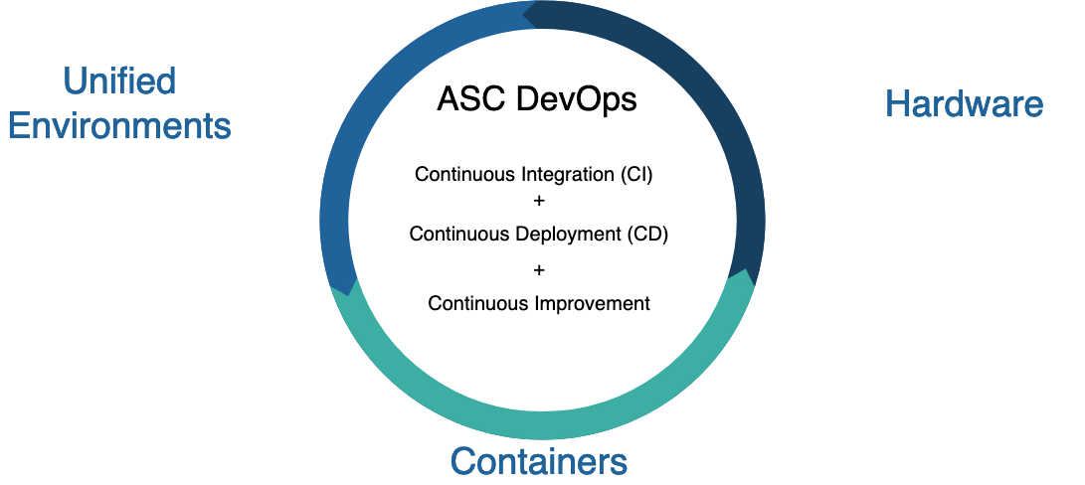
Advanced Simulation and Computing (ASC) DevOps Initiative
ASC DevOps Vision
ASC codes are developed, tested, deployed, and released quickly, efficiently, and robustly with established credibility on all key ASC platforms. Codes are efficiently coupled and integrated in the ASC DevOps ecosystem, which is governed by well-defined processes, practices, and standards. Ultimately, end-users will be able to seamlessly run recently released credible ASC code(s) on key ASC platforms.
Complicated Effort
Multiple prior attempts
Required a new, different approach
Essentials to success
Communication & Governance Structure
Broad consensus, from technical staff up to senior management
Team Building & Managing Change
Managing complexity & Effort
Software ecosystem and library dependencies

Slide 3
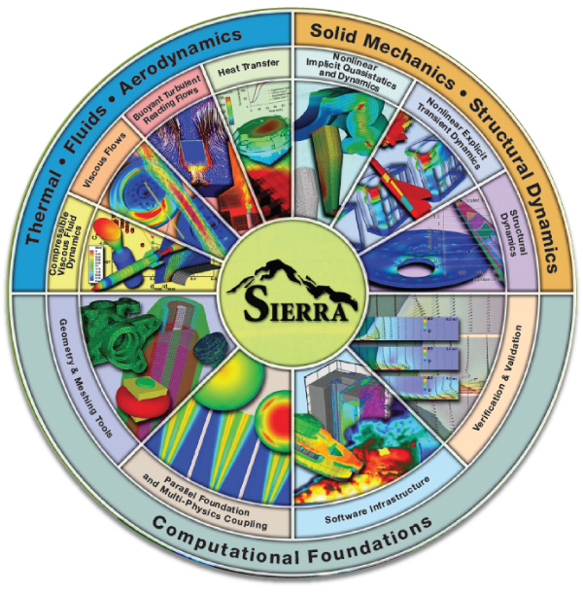
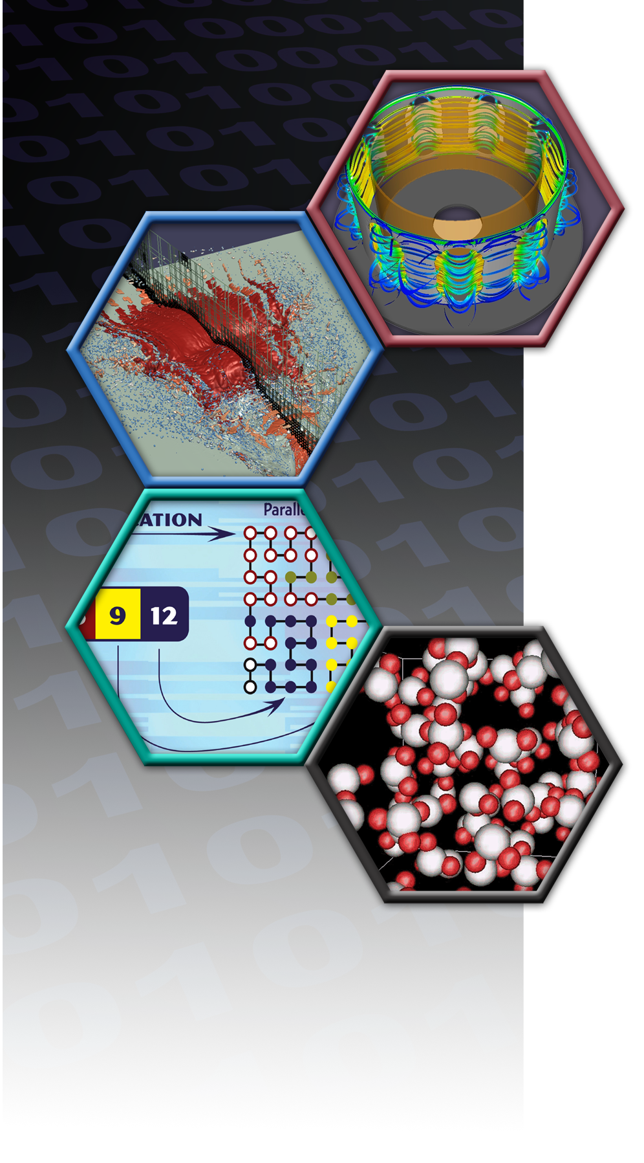
ASC and a Unified Environment at Sandia
Sub-program Integration
Codes + Models + Credibility
+ HPC Systems, Operations, & Software Stack
Scope
31 Scientific & Engineering Code Teams and multiple systems admin. teams
HPC: Prototype, Advanced, and Commodity
Desktop: Windows, Linux, Mac
200+ Developers
Partner daily with users (designers & analysts)
History
Some teams on build systems pre-date1995
Multiple attempts at unified ASC DevOps

Slide 4
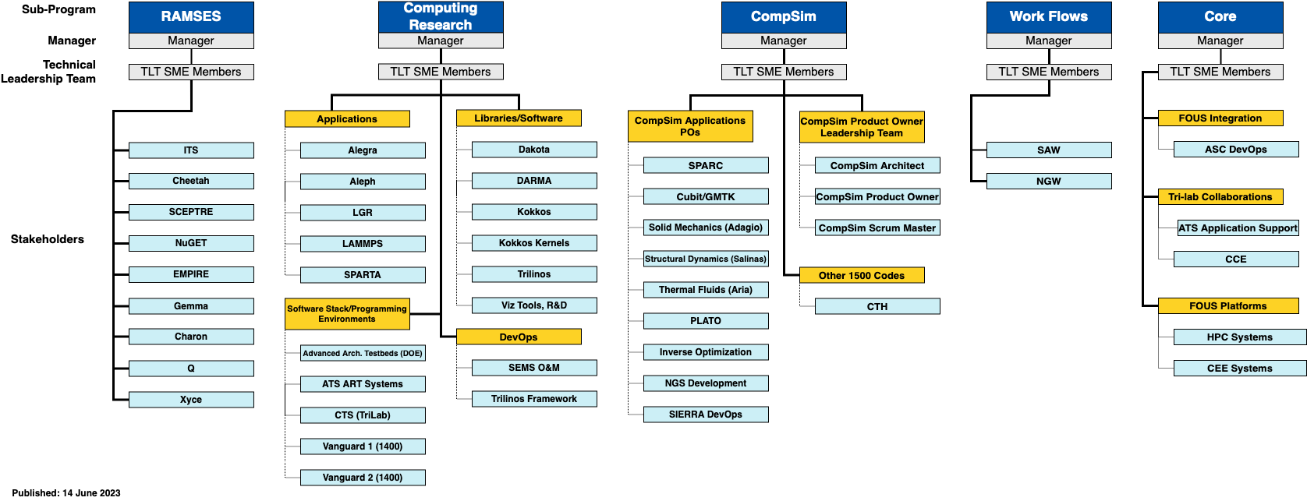
ASC Technical Leadership Team (TLT) and Stakeholders
TLT & Stakeholders
13 member body of staff SME’s
Distinct by sub-program
Stakeholders needs communicated through TLT representatives

Slide 5
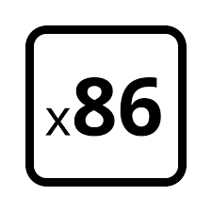
ASC Unified Environment
Continuous Integration
Heterogenous Architectures
Network Hierarchy
OPEN SECURE CLASSIFIED
The ASC Unified Environment Stack
Tooling, Profilers, & Debuggers
9 tooling products
5 profilers & debuggers
Compilers & MPI
5 compilers
2 flavors of MPI
TPLs
13 TPLs
34 products, multiple architectures, multiple networks, many combinatorics
Notes:
HDF5 (Hierarchical Data Format Version 5) = File management system (open source file format that supports large, complex, heterogenous data)
NetCDF (Network Common Data Form) is a network data form, a set of interfaces for scientific data. data storage format that Exodus is build on

Slide 6
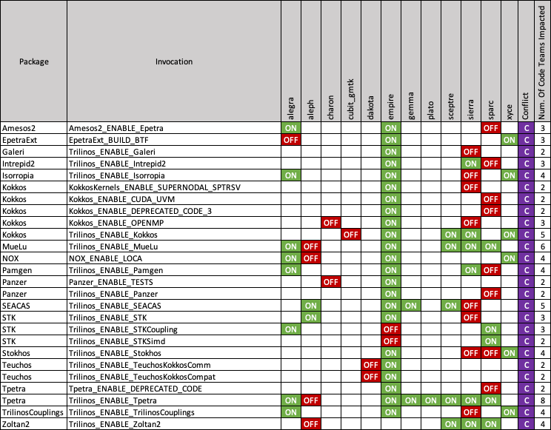
Trilinos Planning Team
Solver Library (Trilinos) Builds: Motivating down-select of configurations
Configuration Options
(27 out of 326)
Code Teams
(none of which have the same configuration)
Solver Package

Slide 7
Strategies for the common build
Build a (or a set of) common Trilinos with all variants that any code team wants enabled
Using Spack
Concerns:
Will this impact runtime performance?
Build systems
Tribits vs CMake
Versions of the dependencies?
Are there conflicts by enabling certain packages will others need to be disabled?
Currently we don't see any conflicts

Slide 8
List of Variants enabled
44 of 51 Trilinos Packages
Adelus | Isorropia | Shards
Amesos | Kokkos | Stokhos
Amesos2 | ML | Stratimikos
Anasazi | MueLu | Teko
AztecOO | NOX | Tempus
Belos | Pamgen | Teuchos
Epetra | Panzer | Thyra
EpetraExt | Percept | Tpetra
FEI | Phalanx | Trilinos
Galeri | Piro | TrilinosCouplings
Gtest | ROL | TrilinosSS
Ifpack | RTOp | Triutils
Ifpack2 | SEACAS | Xpetra
Intrepid | STK | Zoltan
Intrepid2 | Sacado | Zoltan2

Slide 9
Product delivery
Configuration of Trilinos
Codes still build Trilinos
Consistent build formula, which can reduce debugging time
Build Cache
Reduces build time
Get Trilinos + dependencies
Code teams can selectively reuse certain software and customize others
Must use Spack
Offers the most time savings with the most flexibility
Common Set of Builds
Modules
No need to build Trilinos
Challenge is to get the code teams on the same page or at least the same chapter
Nightly Trilinos Integration Build
Several code teams build and integrate Trilinos into their code each night
Take over the responsibility of providing the latest Trilinos so multiple code teams are not rebuilding

Slide 10
Scope of challenge/landscape
Compilers
GCC 10.3.0
GCC 12.1.0
Intel
Clang
OpenMPI
Built on all the compilers
Intel MPI
Variants of the common build
Complex vs Noncomplex
Float vs Int
GPU's
Cuda
ROCM

Slide 11
AUE Compilers and tpls
Ancillary benefit of this projects: we will be able to test the products released under AUE for suitability with Trilinos
Reuse TPLs that are provided with the AUE environment
Shared Trilinos & AUE TPLs
BLAS
Boost
CGNS
HDF5
Hypre
LAPACK
NetCDF
METIS
ParMetis
SuperLU

