Slide 1
A Distributed-Memory Schur-complement PCA Preconditioner for Gemma Ill-conditioned Problems
Vinh Dang and Joseph Kotulski (1352)
vqdang@sandia.gov, jdkotul@sandia.gov
Trilinos User Group Meeting 2023
October 30th - November 2nd
SAND 1727220
Notes:
Today I am going to talk about our ongoing work “A Distributed-Memory Implementation of Schur-complement PCA Preconditioner for Gemma Ill-conditioned Problems”

Slide 2
Outline
Overview of Electromagnetic Radiation (EMR) Problem
Motivation and Objective
Performance Portability
Overview of the Schur-complement Principal Component Analysis (PCA) Preconditioner
Parallel Implementation
Distributed Binary Tree
Schur-complement PCA Factorization
Generalized Conjugate Residual (GCR) Solver
Numerical Results
Conclusions and Future Work
Notes:
I begin with an overview of the EMR problem that our group currently focuses on
Secondly, I will talk about the motivation and objective of our research work
Next, I will discuss about …
Some experimental results will be followed
Finally are the conclusions and our future work

Slide 3
Electromagnetic Radiation (EMR) Problem Overview
Notes:
First, we will give an overview of the EMR problem.

Slide 4
EMR Problem Overview
Electromagnetic (EM) energy couples into systems in many different ways. Our focus is energy coupling through mechanical seams or joints in the system housing, which acts as a good but imperfect EM shield. The joints form slots that allow EM energy into the system. Therefore, the problem has two parts that must be well-characterized: the slot and the cavity.
EMR/HPEM
Induced currents
Magnetic diffusion
EMR/HPEM
Filter
Connector
Metal Enclosure (Shield)
Notes:
Metallic enclosures are commonly used to protect electronic circuits against unwanted electromagnetic (EM) interactions.
Electromagnetic (EM) energy couples into systems in many different ways.
However, our focus is energy coupling through mechanical seams or joints in the form of narrow slots on the enclosure
This coupled EM energy can severely affect the circuit operation, particularly at the cavity resonant frequencies since the cavity has a high Q factor.

Slide 5
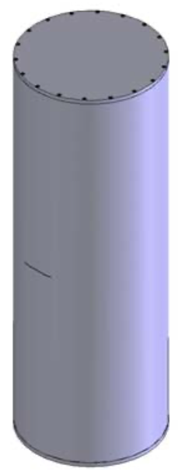
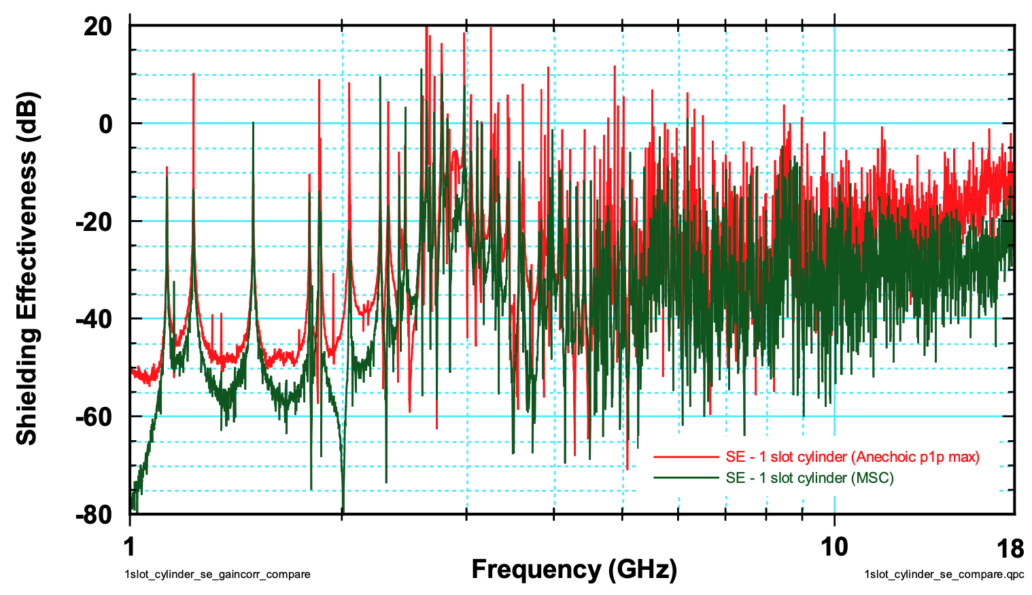
Shielding Effectiveness against Frequency for the Higgins Cylinder
The 2” slot is halfway up the cylinder. A monopole probe is located inside the cylinder on one of the ends
Cylinder shielding effectiveness $SE=20 \log_{10}\left(\frac{E_{interior}}{E_{exterior}}\right)$ in the mode-stirred and anechoic chambers
[1] Matthew B. Higgins and Dawna R. Charley, Electromagnetic Radiation (EMR) Coupling to Complex Systems: Aperture Coupliing into Canonical Cavities in Reverberant and Anechoic Environments and Model Validation, SAND2007-7931
Notes:
Consider the cylinder on the left with a slot halfway up.
A monopole probe is located inside the cylinder on one of the ends.
The plot on the right shows the total response at a single, constant probe location over a large frequency range.
On the vertical axis, shielding effectiveness (SE) is equal to 20 log_10 of the interior field divided by the incident field, which is our primary quantity of interest.
Thus, a higher SE corresponds to a higher interior field.
The “spiky” peaks appear at frequencies where the cavity has resonances.
Next, we’ll look at the slot resonance.

Slide 6
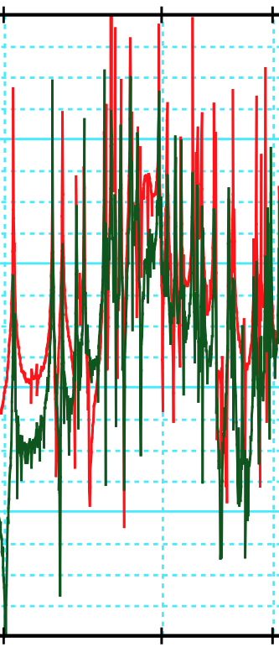
Shielding Effectiveness against Frequency for the Higgins Cylinder
When the slot is at a resonance, it provides a larger drive to the cavity → the cavities modes have larger field magnitudes
Therefore, the slot and the cavity have to be well-characterized at resonances
The 2” slot is halfway up the cylinder. A monopole probe is located inside the cylinder on one of the ends
[1] Matthew B. Higgins and Dawna R. Charley, Electromagnetic Radiation (EMR) Coupling to Complex Systems: Aperture Coupliing into Canonical Cavities in Reverberant and Anechoic Environments and Model Validation, SAND2007-7931
Notes:
Now let zoom in to a particular frequency range, from 2 to 4 GHz, as shown in the plot on the right
Again, the sharp narrow peaks are at cavity resonances.
When the slot is at a resonance (the orange wide peak) it is providing a larger drive to the cavity, lifting up the entire response.
So, the slot and the cavity have to be well-characterized at their resonances

Slide 7
Motivation and Objective
Notes:
Next is about our motivation and objective

Slide 8
SNL’s Electromagnetic Code Gemma
Frequency-domain EM
Hybrid approach, using:
A narrow slot sub-cell model to represent slots and the corresponding coupling
Surface integral equation method for outer region and inner region of cavity
Slot-Slot
Surface-Slot
Slot-Suface
Outer
Surface
×
=
Inner
Surface
Electric field integral equation (EFIE), for simplification:
Surface-Suface
$$\text{A}$$
$$\text{x}$$
$$\text{b}$$
Expand unknown in a set of RWG basis functions:
When an iterative method is used to solve the large, dense, complex matrix equation system:
A is extremely ill-conditioned for the problem of interest
Effective and efficient preconditioning is required
Test integral equation with RWG basis functions:
Notes:
At Sandia, we developed the electromagnetic code Gemma based on MoM.
This is a hybrid frequency domain approach, where:
- A narrow slot sub-cell model to represent the slot and the corresponding coupling
- Surface integral equation method for outer region and inner region of the cavity: I am showing the EFIE formulation for demonstration purpose where we use RWG basis functions for the expansion and the testing

Slide 9
Objective
A preconditioner using Schur-complement and Principal Component Analysis (PCA) on distributed-memory accelerator-based computing platforms for dense matrices (an extension of our collaboration with Ohio State University EM group)
Propose a hierarchical binary distribution scheme for the binary tree
Target performance portability
For use with the Multilevel Fast Multipole Method (MLFMM) or the Adaptive Cross Approximation (ACA) for future work
Notes:
- So, the objective of this work is to develop a preconditioner using Schur-complement and PCA on distributed-memory accelerator-based computing platforms for dense matrices. This is an extension of our collaboration with the EM group at Ohio State University
+ We propose a hierarchical binary distribution scheme over a distributed-memory system for the binary tree used by. the preconditioner
+ We target performance portability across different computing architectures
+ This implementation will lay the groundwork for the use with the Multilevel Fast Multipole Method (MLFMM) or the Adaptive Cross Approximation (ACA) in our future work

Slide 10
Performance Portability

Slide 11
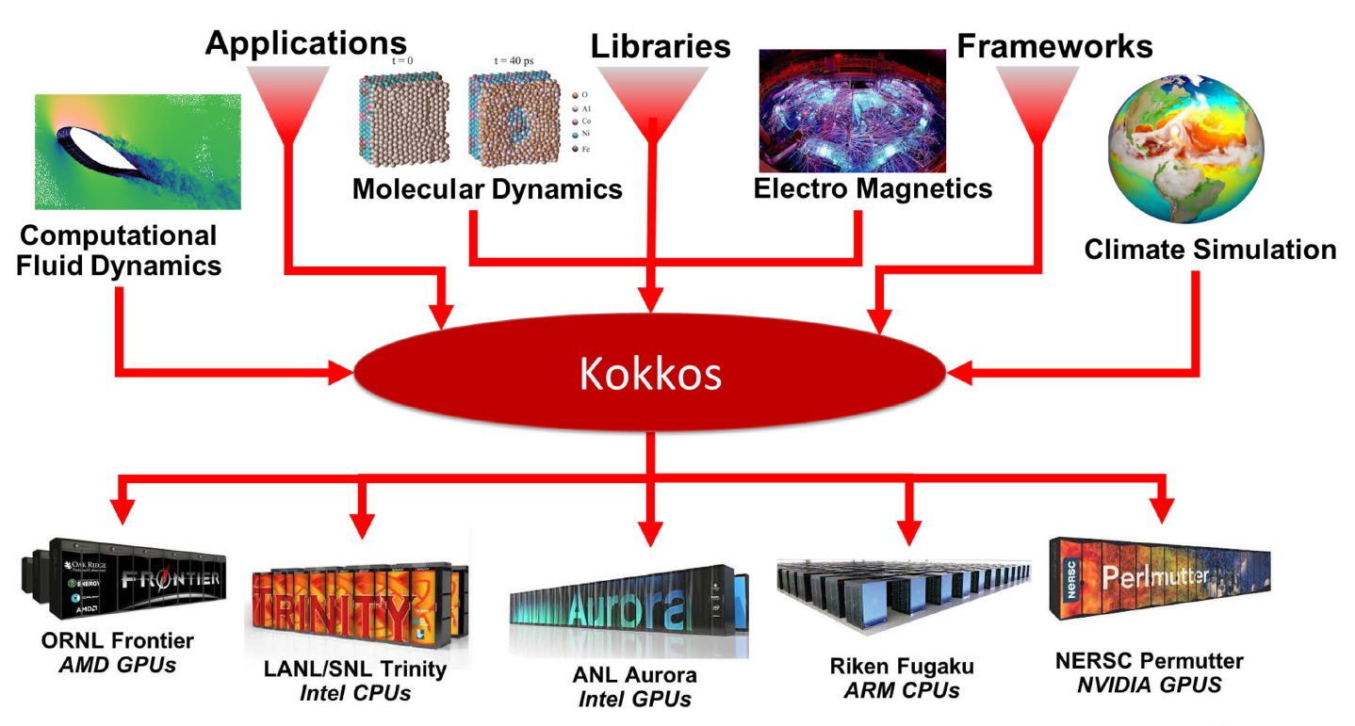
Performance Portability with Kokkos and Kokkos Kernels
Electromagnetics
Gemma is written on top of Kokkos (an open-source productive, portable, performant, shared-memory programming model) and Kokkos Kernels (a library for node-level, performance-portable, computational kernels for sparse/dense linear algebra and graph operations)
[2] C. Trott et al., "The Kokkos EcoSystem: Comprehensive Performance Portability for High Performance Computing," in Computing in Science & Engineering, vol. 23, no. 5, pp. 10-18, 1 Sept.-Oct. 2021

Slide 12
Overview of the Schur-complement PCA Preconditioner
Notes:
In the next section, I will discuss …

Slide 13
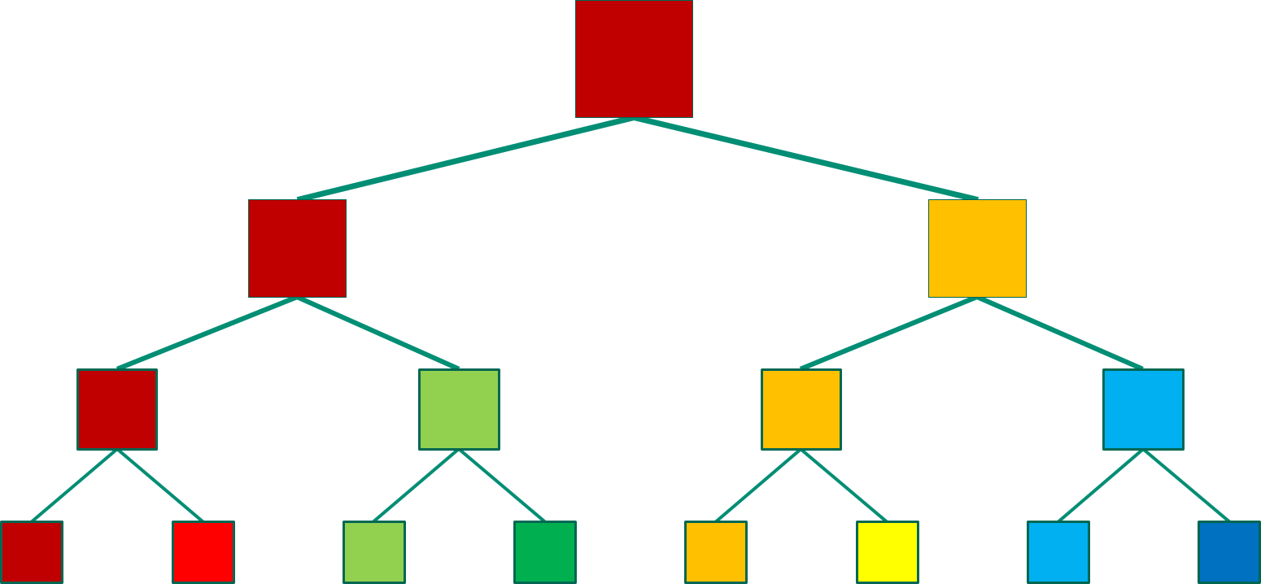
Schur-complement PCA Preconditioner
$${\text{A}}_{1}^{l+1}$$ | $${\text{C}}_{12}^{l+1}$$
$${\text{C}}_{21}^{l+1}$$ | $${\text{A}}_{2}^{l+1}$$
 |  | $${\text{A}}_{3}^{l+1}$$ | $${\text{C}}_{34}^{l+1}$$
 |  | $${\text{C}}_{43}^{l+1}$$ | $${\text{A}}_{4}^{l+1}$$
$${\text{A}}_{1}^{l}$$
Level l
$${\text{A}}_{2}^{l}$$
Level l+1
$${\left({\text{A}}_{1}^{l}\right)}^{−1}=\left[\begin{matrix}\text{I} & 0 \\ −{\left({\text{A}}_{2}^{l+1}\right)}^{−1}{\text{C}}_{21}^{l+1} & \text{I}\end{matrix}\right]\left[\begin{matrix}{\left(\text{I}−{\left({\text{A}}_{1}^{l+1}\right)}^{−1}{\text{C}}_{12}^{l+1}{\left({\text{A}}_{2}^{l+1}\right)}^{−1}{\text{C}}_{21}^{l+1}\right)}^{−1} & 0 \\ 0 & \text{I}\end{matrix}\right]$$
$$\left[\begin{matrix}\text{I} & −{\left({\text{A}}_{1}^{l+1}\right)}^{−1}{\text{C}}_{12}^{l+1} \\ 0 & \text{I}\end{matrix}\right]\left[\begin{matrix}{\left({\text{A}}_{1}^{l+1}\right)}^{−1} & 0 \\ 0 & {\left({\text{A}}_{2}^{l+1}\right)}^{−1}\end{matrix}\right]$$
$${\text{A}}_{5}^{l+1}$$ | $${\text{C}}_{56}^{l+1}$$
$${\text{C}}_{65}^{l+1}$$ | $${\text{A}}_{6}^{l+1}$$
 |  | $${\text{A}}_{7}^{l+1}$$ | $${\text{C}}_{78}^{l+1}$$
 |  | $${\text{C}}_{87}^{l+1}$$ | $${\text{A}}_{8}^{l+1}$$
$${\text{A}}_{3}^{l}$$
Factorization using PCA:
$${\left({\text{A}}_{1}^{l+1}\right)}^{−1}{\text{C}}_{12}^{l+1} \underset{→}{PCA} {\text{L}}_{1}^{l+1}{\text{D}}_{1}^{l+1}{\text{R}}_{1}^{l+1}={\text{L}}_{1}^{l+1}{\text{R}}_{1}^{l+1}$$
$${\left({\text{A}}_{2}^{l+1}\right)}^{−1}{\text{C}}_{21}^{l+1} \underset{→}{PCA} {\text{L}}_{2}^{l+1}{\text{D}}_{2}^{l+1}{\text{R}}_{2}^{l+1}={\text{L}}_{2}^{l+1}{\text{R}}_{2}^{l+1}$$
$${\text{A}}_{4}^{l}$$
Inverse of Schur-complement:
Store: ${\text{L}}_{1}^{l+1}\left(m×k\right),{\text{R}}_{1}^{l+1}\left(k×n\right)$
$${ \text{L}}_{2}^{l+1}\left(n×q\right),{\text{R}}_{2}^{l+1}\left(q×m\right)$$
$S^{l}\left(k×q\right)$
$${\left(\text{I}−{\left({\text{A}}_{1}^{l+1}\right)}^{−1}{\text{C}}_{12}^{l+1}{\left({\text{A}}_{2}^{l+1}\right)}^{−1}{\text{C}}_{21}^{l+1}\right)}^{−1}≈{\left(\text{I}−{\text{L}}_{1}^{l+1}{\text{R}}_{1}^{l+1}{\text{L}}_{2}^{l+1}{\text{R}}_{2}^{l+1}\right)}^{−1}$$
$$=\text{I}+{\text{L}}_{1}^{l+1}{\left(\text{I}−{\text{R}}_{1}^{l+1}{\text{L}}_{2}^{l+1}{\text{R}}_{2}^{l+1}{\text{L}}_{1}^{l+1}\right)}^{−1}{\text{R}}_{1}^{l+1}{\text{L}}_{2}^{l+1}{\text{R}}_{2}^{l+1}=\text{I}+{\text{L}}_{1}^{l+1}S^{l}{\text{R}}_{2}^{l+1}$$
Notes:
The system matrix is hierarchically partitioned and mapped to a binary tree
where A are block diagonal matrices corresponding to binary tree nodes at a level
And C denote coupling matrices between nodes at the same level
(Animation)
The inverse of A at level l is expressed involving inverses of block diagonal matrices and coupling matrices from level l+1 and the inverse of Schur complement
The matrix products Ainv*C can be factorized into the form of L and R matrices using the PCA
The inverse of Schur-complement is approximated by these L and R matrices
Eventually, for a particular node at level l, we only need the L and R matrices from the two child nodes and a small matrix S of the current node

Slide 14
Schur-complement PCA Preconditioner
$${\text{A}}_{1}^{l}$$ | $${\text{C}}_{12}^{l}$$
$${\text{C}}_{21}^{l}$$ | $${\text{A}}_{2}^{l}$$
Level l-1
$${\text{A}}_{1}^{l−1}$$
Level l
$${\left({\text{A}}_{1}^{l−1}\right)}^{−1}=\left[\begin{matrix}\text{I} & 0 \\ −{\left({\text{A}}_{2}^{l}\right)}^{−1}{\text{C}}_{21}^{l} & \text{I}\end{matrix}\right]\left[\begin{matrix}{\left(\text{I}−{\left({\text{A}}_{1}^{l}\right)}^{−1}{\text{C}}_{12}^{l}{\left({\text{A}}_{2}^{l}\right)}^{−1}{\text{C}}_{21}^{l}\right)}^{−1} & 0 \\ 0 & \text{I}\end{matrix}\right]$$
$$\left[\begin{matrix}\text{I} & −{\left({\text{A}}_{1}^{l}\right)}^{−1}{\text{C}}_{12}^{l} \\ 0 & \text{I}\end{matrix}\right]\left[\begin{matrix}{\left({\text{A}}_{1}^{l}\right)}^{−1} & 0 \\ 0 & {\left({\text{A}}_{2}^{l}\right)}^{−1}\end{matrix}\right]$$
$${\text{A}}_{3}^{l}$$ | $${\text{C}}_{34}^{l}$$
$${\text{C}}_{43}^{l}$$ | $${\text{A}}_{4}^{l}$$
$${\text{A}}_{2}^{l−1}$$
Factorization using PCA:
$${\left({\text{A}}_{1}^{l}\right)}^{−1}{\text{C}}_{12}^{l} \underset{→}{PCA} {\text{L}}_{1}^{l}{\text{D}}_{1}^{l}{\text{R}}_{1}^{l}={\text{L}}_{1}^{l}{\text{R}}_{1}^{l}$$
$${\left({\text{A}}_{2}^{l}\right)}^{−1}{\text{C}}_{21}^{l} \underset{→}{PCA} {\text{L}}_{2}^{l+1}{\text{D}}_{2}^{l+1}{\text{R}}_{2}^{l+1}={\text{L}}_{2}^{l+1}{\text{R}}_{2}^{l+1}$$
Inverse of Schur-complement:
Store: ${\text{L}}_{1}^{l}\left(m′×k′\right),{\text{R}}_{1}^{l}\left(k′×n′\right)$
$${ \text{L}}_{2}^{l}\left(n′×q′\right),{\text{R}}_{2}^{l}\left(q′×m′\right)$$
$S^{l−1}\left(k′×q′\right)$
$${\left(\text{I}−{\left({\text{A}}_{1}^{l}\right)}^{−1}{\text{C}}_{12}^{l}{\left({\text{A}}_{2}^{l}\right)}^{−1}{\text{C}}_{21}^{l}\right)}^{−1}≈{\left(\text{I}−{\text{L}}_{1}^{l}{\text{R}}_{1}^{l}{\text{L}}_{2}^{l}{\text{R}}_{2}^{l}\right)}^{−1}$$
$$=\text{I}+{\text{L}}_{1}^{l}{\left(\text{I}−{\text{R}}_{1}^{l}{\text{L}}_{2}^{l}{\text{R}}_{2}^{l}{\text{L}}_{1}^{l}\right)}^{−1}{\text{R}}_{1}^{l}{\text{L}}_{2}^{l}{\text{R}}_{2}^{l}=\text{I}+{\text{L}}_{1}^{l}S^{l−1}{\text{R}}_{2}^{l}$$
Notes:
We repeat the same process when moving up to level l-1

Slide 15
Parallel Implementation

Slide 16
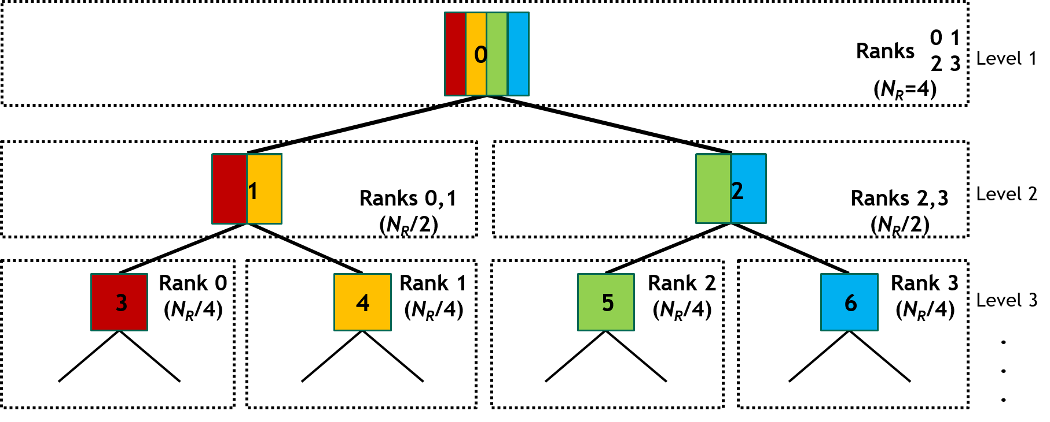
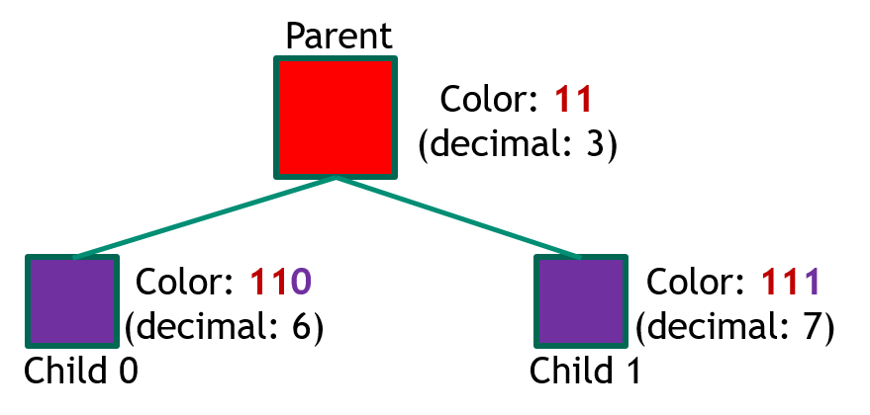
Distributed Binary Tree
Top-down
binary
distribution
Rank 0
Rank 1
Rank 2
Rank 3
Distribution scheme at each level:
Calculate colors for sub-communicators
Calculate colors for each binary-tree nodes
Add nodes to MPI processes if node colors match sub-communicator colors
Binary color calculation:
Colors (binary code) are unique for nodes/communicators in the same binary-tree level
Colors of child nodes/communicators are calculated from colors of their parents
Notes:
I first talk about the binary tree. This is the key component for the Schur-complement PCA preconditioner and the matvec operator in the iterative solver.
The binary tree is built from the octree (insert two sub levels between two octree levels)
Figure shows an example of a binary tree distribution onto 4 MPI processes.
- We develop a top-down binary distribution scheme for the distributed binary tree onto a grid of power of two MPI processes (can be either 1-D grid or 2-D grid).
+When going down from level l to level l+1, two MPI communicators (at level l+1) are created from a parent communicator (at level l).
+ Colors are calculated for binary tree nodes and for communicators.
+ Nodes will be added to MPI processes if their colors match.
+ The process continues until each communicator has one MPI rank.
- Binary color calculation:
Colors (in binary code) are unique for nodes/communicators in the same binary-tree level
Colors of child nodes/communicators are calculated from colors of their parents by shifting left and add 0 to the left child and 1 to the right child

Slide 17
Schur-complement PCA Factorization
What need to be stored in binary tree nodes?
All coupling matrices C
Diagonal block matrices of A at the lowest level
Block matrices of A at higher levels: store the L, R, and S matrices
Block-based matrix distribution if a tree node is handled by more than one MPI rank
Factorization: traversing the binary tree from the finest level up to a user-defined stop level while computing the L, R, and S matrices at each level using the PCA algorithm ^{[3]} (based on singular value decomposition - SVD)
In-house distributed matrix-matrix (vector) multiplication (GEMM/GEMV)
TPLs: singular value decomposition (SVD) and distributed linear equation solver GESV
user-defined
stop level
Bottom-up Traversal for Factorization
0
1
2
3
MPI_Allreduce
0
1
0
1
0
1
2
3
2
3
2
3
Distributed matrix-matrix/vector multiplication
GEMM/V
[3] http://helper.ipam.ucla.edu/publications/setut/setut_7373.pdf
Notes:
- Just to recall: ….
- Note: user-defined stop level allows us to flexibly determine how much information of the matrix A used for the preconditioner, depending on the problem we want to solve
- In-house distributed matrix-matrix (vector) multiplication (GEMM/GEMV): …
- Leverage Third-Party Libraries for singular value decomposition (SVD) and distributed linear equation solver GESV

Slide 18
GCR Solver
Generalized Conjugate Residual (GCR) method ^{[4]} was chosen for its simplicity and effectiveness
Two most computational operations: applying preconditioner and matvec
Applying preconditioner: using the bottom-up traversal as in the factorization and the in-house distributed GEMV with on-the-fly inverse matrices calculated from the stored L, R, and S matrices at each level
Distributed binary-tree based matvec:
using the diagonal block matrices of A and the coupling matrices C
using the entire binary tree
output of a level becomes input for its upper level
using MPI_Allreduce to gather final results
Bottom-up Traversal for Matvec
[4] Yousef Saad, Iterative Methods for Sparse Linear Systems; SIAM, 2003
Notes:
Generalized Conjugate Residual (GCR) method was chosen for its simplicity for parallel implementation and its effectiveness for our problem of interest. Our preliminary tests showed that the Schur-PCA preconditioner also works with other iterative solvers such as the BICGSTAB, GMRES.
The two most computational operations in an iterative solver are the preconditioner apply and matvec
- Applying preconditioner: using the bottom-up traversal as in the factorization and the in-house distributed GEMV with on-the-fly inverse matrices calculated from the stored L, R, and S matrices at each level
- Distributed binary-tree based matvec: using the diagonal block matrices of A and the coupling matrices C with the entire binary tree. At the finest level, multiply with diagonal blocks

Slide 19
GCR Solver
Generalized Conjugate Residual (GCR) method ^{[4]} was chosen for its simplicity and effectiveness
Two most computational operations: applying preconditioner and matvec
Applying preconditioner: using the bottom-up traversal as in the factorization and the in-house distributed GEMV with on-the-fly inverse matrices calculated from the stored L, R, and S matrices at each level
Distributed binary-tree based matvec:
using the diagonal block matrices of A and the coupling matrices C
using the entire binary tree
output of a level becomes input for its upper level
using MPI_Allreduce to gather final results
Bottom-up Traversal for Matvec
[4] Yousef Saad, Iterative Methods for Sparse Linear Systems; SIAM, 2003
Notes:
And output of a level becomes input for its upper level. At higher levels, we multiply with only coupling matrices C

Slide 20
GCR Solver
Generalized Conjugate Residual (GCR) method ^{[4]} was chosen for its simplicity and effectiveness
Two most computational operations: applying preconditioner and matvec
Applying preconditioner: using the bottom-up traversal as in the factorization and the in-house distributed GEMV with on-the-fly inverse matrices calculated from the stored L, R, and S matrices at each level
Distributed binary-tree based matvec:
using the diagonal block matrices of A and the coupling matrices C
using the entire binary tree
output of a level becomes input for its upper level
using MPI_Allreduce to gather final results
Bottom-up Traversal for Matvec
[4] Yousef Saad, Iterative Methods for Sparse Linear Systems; SIAM, 2003

Slide 21
GCR Solver
Generalized Conjugate Residual (GCR) method ^{[4]} was chosen for its simplicity and effectiveness
Two most computational operations: applying preconditioner and matvec
Applying preconditioner: using the bottom-up traversal as in the factorization and the in-house distributed GEMV with on-the-fly inverse matrices calculated from the stored L, R, and S matrices at each level
Distributed binary-tree based matvec:
using the diagonal block matrices of A and the coupling matrices C
using the entire binary tree
output of a level becomes input for its upper level
using MPI_Allreduce to gather final results
Bottom-up Traversal for Matvec
[4] Yousef Saad, Iterative Methods for Sparse Linear Systems; SIAM, 2003
Notes:
MPI_Allreduce is needed to gather final results at the end

Slide 22
Numerical Results
Notes:
Now let’s look at some results

Slide 23
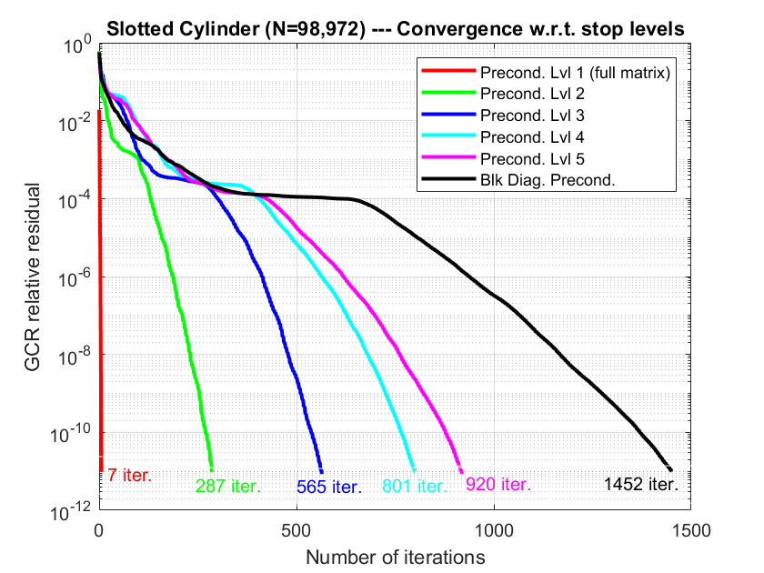
Simulation Setup and Convergence Behavior
High-Q factor slotted cylindrical cavity at f = 1.1295GHz (near resonance) with 98,972 unknowns
The matrix and RHS vector are generated by the method of moments code EIGER
Schur-PCA tolerance: 10e-5 and GCR solver tolerance: 10e-11
Test platform: LLNL’s Lassen with POWER9 CPUs, V100 GPUs, gcc/8.3.1, cuda/11.8.0, essl/6.3.0.1, lapack/3.10.0-xl-2022.03.10, spectrum-mpi/rolling-release
Lvl 1 → using the whole binary tree
Lvl 8 (finest level) → block diagonal preconditioner
The convergence rate is fastest with lvl 1 and reduces (i.e. more iterations) when we increase the stop level
The iteration change is significant from 7 (lvl 1) to 287 (lvl 2) and 1452 (lvl 8)
Notes:
On the right figure, I am showing the convergence rates for preconditioners with different stop levels
+ Lvl 1 denotes using the entire tree for the preconditioner, while Lvl 8 denotes the block diagonal preconditioner
- With lvl 1, the GCR converges very fast, after 7 iterations
- However, it needs significantly more iterations to converge when partial matrix is used for the preconditioner (meaning increase the stop level). For example: 287 iterations with lvl 2 and 1452 iterations with lvl 8
- It can be misleading if just looking at the number of iterations. Next, we will look at run times

Slide 24
CPU and GPU Executions at Different Stop Levels
16 computing nodes with 16 MPI ranks (1 rank per node): 44-core CPUs per rank vs. 1 GPU per rank
The factorization time (blue) decreases as the stop level increases while the solve time (orange) increases with more iterations and becomes dominant in the total time (green)
As the stop level increases, the memory requirement of the Schur-PCA factorization are less while the memory requirement of Krylov subspace is higher
Should use a stop level corresponding to the middle of the binary tree to balance between run time and memory footprint
GPU runs at stop levels of 3, 4, 5, 8 due to GPU memory limitation
GPU execution is ~2.3x faster CPU execution
Notes:
Larger memory footprint on next-gen GPU on next-gen HPC, such as El Capitan

Slide 25
Schur-PCA Preconditioner + GCR vs. ADELUS: Scalability
The total CPU run times with stop levels 1 and 5 are compared with those of the direct solver ADELUS on 2 ranks, 4 ranks, 8 ranks, 16 ranks, 32 ranks
Schur-PCA Preconditioner + GCR outperforms ADELUS
Scalability needs optimization as the number of MPI ranks increases (current limitation: use of full-size vectors)
Notes:
Note: ADELUS is a performance-portable dense LU solver for distributed-memory hardware-accelerated systems in the Trilinos framework developed at Sandia and it is used by our Gemma as a direct solver

Slide 26
Conclusions and Future Work
Developed a parallel implementation of the Schur-complement PCA preconditioner on distributed-memory systems with Kokkos for performance portability
Effective in solving ill-conditioned problems
Schur-complement PCA preconditioner + GCR on CPUs is faster than ADELUS
Future work:
Has just been integrated into Gemma: full performance with on-the-fly matrix construction will be done next
Performance optimization to achieve better scalability on larger computing systems for larger sized problems
Thank You!

Slide 27
Backup
Notes:
Now let’s look at some numerical results

Slide 28
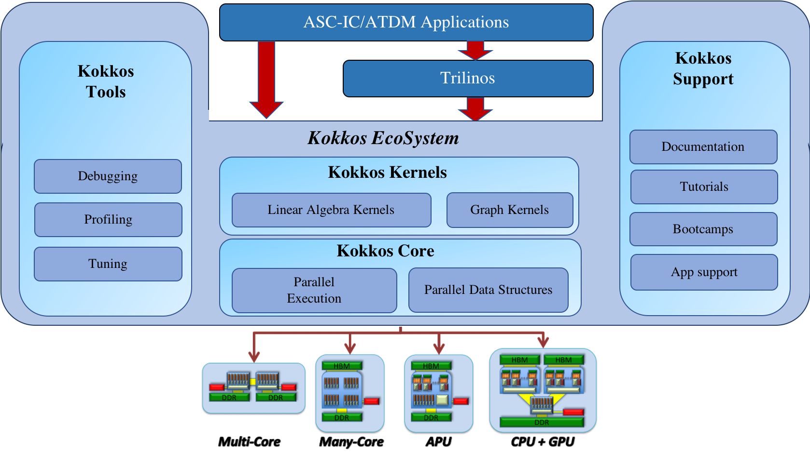
Kokkos Kernels Overview
Kokkos Kernels is a library for node-level, performance-portable, computational kernels for sparse/dense linear algebra and graph operations, using the Kokkos
KK is available publicly both as part of Trilinos and as part of the Kokkos ecosystem (https://github.com/kokkos/kokkos-kernels)
Building block of a solver, linear algebra library that uses MPI and threads for parallelism, or it can be used stand-alone in an application
Interfaces to vendor-provided kernels available in order to leverage their high-performance libraries
Notes:
Kokkos Kernels is a library for node-level, performance-portable, computational kernels for sparse/dense linear algebra and graph operations, using the Kokkos.
KK is available publicly both as part of Trilinos and as part of the Kokkos ecosystem (https://github.com/kokkos/kokkos-kernels)
We depend on the Kokkos Kernels library for BLAS and LAPACK functionality on CPUs and GPUs.
Kokkos Kernels provides interfaces to available vendor-provided kernels in order to leverage their high-performance libraries

Slide 29
Binary Tree-Based Inverse Matrix-Vector Multiplication

