Slide 1
Trilinos Autotester Changes
Eric Ho, Sam Browne
SAND2023-11784PE
Notes:
Pipeline from contributions to merge

Slide 2
Current Autotester
Open Pull Request on Trilinos Repository
Autotester detects PR and sends out jobs
GCC 8.3.0
Export Results
Block/Unblock Merge
GCC 8.3.0 Serial
Clang 11.0.1
Intel 2021.3.0
GCC 10.1+ CUDA 11
GCC 8.3.0 Shared
Notes:
Requirements of Autotester
Make Open Source Contributions easier
Keep Trilinos working
Keep Sandia Secure

Slide 3
Challenges with current Autotester
Unable to restart individual builds within a PR
i.e. GCC build passes and Intel build fails, both must be restarted to pass PR
Developers cannot monitor in-progress PR test results.
Test results are published as pass/fail on Github. Test Results are not visible to external developers.
Solution?

Slide 4
CURRENT AUTOTESTER
AUTOMATED PR TESTING CONCURRENT PR TEST BUILDS VIEW PR TESTING STATUS | AUTOMATED PR TESTING CONCURRENT PR TEST BUILDS VIEW PR TESTING STATUS GITHUB ACTIONS INTEGRATION EXPORT RESULTS TO GITHUB AND CDASH REAL-TIME PROGRESS TRACKING CONTAINERIZED PR TESTS WITH DOWNLOADABLE DOCKER IMAGES RESTART INDIVIDUAL PR BUILDS
Notes:
Autotester4Github
CI/CD pipeline that uses Github Actions and Self-hosted runners
Talk more about Containerized PR Test Environment on Thursday

Slide 5
See Exactly how PR Tests are executed

Slide 6
How does this affect Trilinos Developers?
Hopefully, it doesn’t
Reduced time: PR opened -> Ability to Merge
Streamlined test results
Access to containerized test environments

Slide 7
Current Status and Future Plans
AT4G is in development. Not public.
AT4G runs alongside current AutoTester. Will not be required for merge.
AT4G replaces current AutoTester. Target FY25 Q1.

Slide 8
Demo

Slide 9
Triggering AT4G with a label

Slide 10
Viewing the status of PR Checks

Slide 11
Live output of test build

Slide 12
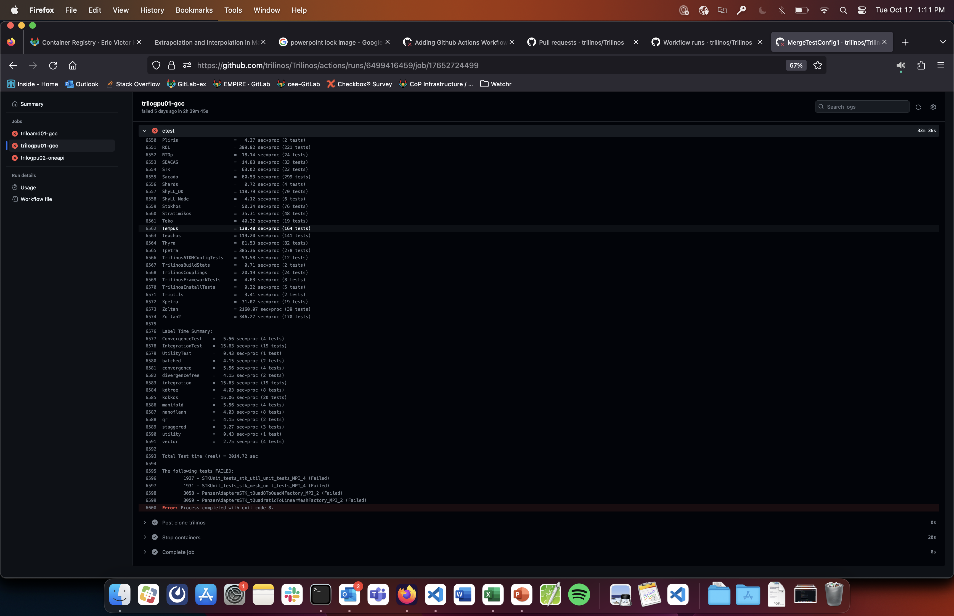
Detailed view of test failures

Slide 13
Questions?

