Slide 1
Percept
Verification tools for computational simulation
Kevin Copps (kdcopps@sandia.gov),
Brian Carnes, Steve Kennon
Trilinos User Group Meeting 2014 October
SAND2014-19222 PE

Slide 2
What is Percept?
Goal: Provide a software package enabling parallel mesh refinement (h-method) conforming to CAD geometry, as well as mesh adaptivity, mesh smoothing, convergence analysis, norm calculations, field transfer and field differencing, and support for the method of manufactured solutions.
A set of libraries and command line tools
BSD Open source license
Uses Trilinos libraries: STK, Intrepid, Teuchos
CAD geometry handoff from Cubit to openNURBS data
Reads and writes the ExodusII mesh database format

Slide 3
What is Percept?
Libraries:
adapt – a C++ API and library for refining and adapting a STK mesh
adapt_lite – a version of adapt library without openNURBS dependencies
percept – a C++ API and library for performing pre- and post-processing operations on a STK mesh
percept_lite – a version of percept library without openNURBS dependencies
percept.py – a Python API and library exposing the capabilities of adapt and percept libraries
mms – a C++ API and library for representing functions for the method of manufactured solutions
Tools:
mesh_adapt – a command line tool to refine and adapt unstructured ExodusII format meshes
percept_verifier_mesh – a command line tool to ensure consistency and correctness of meshes
percept_mesh_diff – a command line tool to report differences in two ExodusII format meshes
eigen_verify – a command line tool to perform a convergence analysis on eigenmodes
mesh_transfer – a command line tool to transfer representations of physical fields from a 2D or 3D ExodusII mesh to another ExodusII mesh that partially overlaps the first

Slide 4
Trilinos Libraries used in Percept
STK – parallel mesh and field database
Aura enables easy ghosting of neighbor mesh/field data
Demonstrated robustness for parallel, scalable mesh modification
Intrepid
Element basis function support (norms, transfers, search)
SEACAS
Interface to read/write ExodusII files
Auto mesh decomp and join utilities
Shards
Cell topology
Teuchos
Command line parsing
RCP

Slide 5
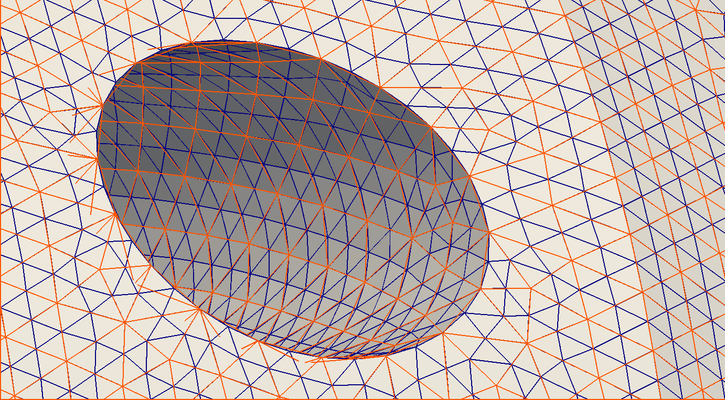
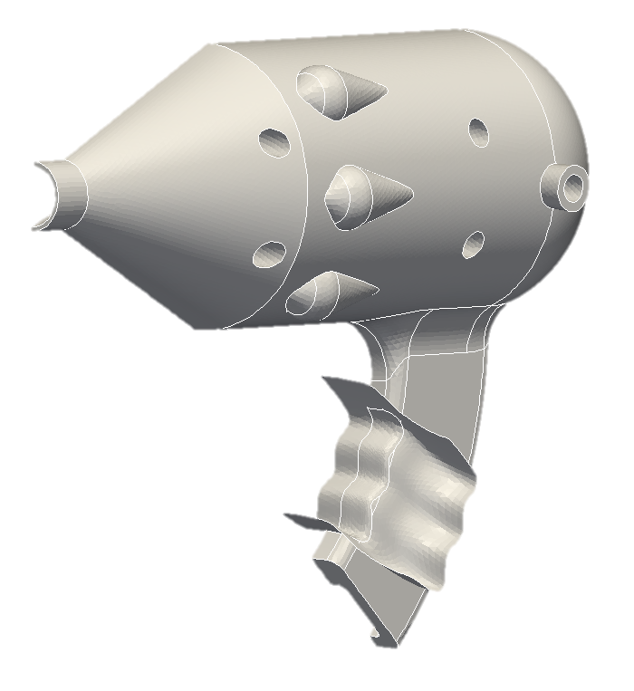
Huge Mesh Sequences and CAD Geometry
UMR creates sequences of grids by mesh doubling
11.6B cells demonstrated w/CAD geometry (6 sequential refinements)
8.9B cells generated by Percept for Nalu (5 refinements)
Enables sub-millimeter resolution on m³ domain
Workflow uses in memory mesh decomposition: read single input mesh, distribute in parallel
Notes:
DAT on Chama 3/19/13 – combined stk_nalu and stk_adapt runs
Shook out several issues in stk_adapt and exodus related to using 32bit instead of 64bit integers – these only showed up on the largest runs and the DAT was critical to being able to run large jobs, debug, change code and re-run
Outstanding support from the Capviz team
Led to some continued investigations needed to improve performance and usability
Generated (by uniform refinement) 11.6B mesh with CAD Geometry projection and smoothing – Gluegun case from Cubit test suite – 1024nodes/16K cores
no apparent issues with all processors reading from the same CAD 3dm file (we had issues on Redsky with this - unpredictable runtimes due to file contention is the suspected issue)
Generated 9B mesh (open jet) that can be used for T/F FY13 L2 Milestone runs – 16K cores
For O(1 m³) domains, we can now attain sub-millimeter resolution

Slide 6
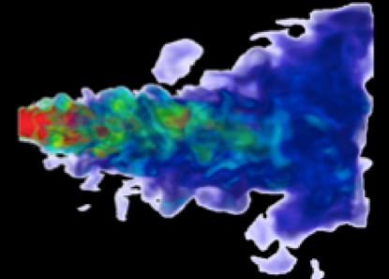
Enabling Large Simulations
Percept used to create mesh for Nalu simulation, also used Trilinos solver libraries.
65k cores execution on 9 billion element unstructured hex mesh
Turbulent open jet (Re = 6k), see Abdel, et al.
Volume rendered mixture fraction
Equation System | Size | DOF | Solver Stack
Momentum | 3x3 | 27 billion | Tpetra/ifpack2/belos
Pressure | 1x1 | 9 billion | Tpetra/MueLu
Turbulent KE | 1x1 | 9 billion | Tpetra/ifpack2/belos
Mixture Fraction | 1x1 | 9 billion | Tpetra/ifpack2/belos

Slide 7
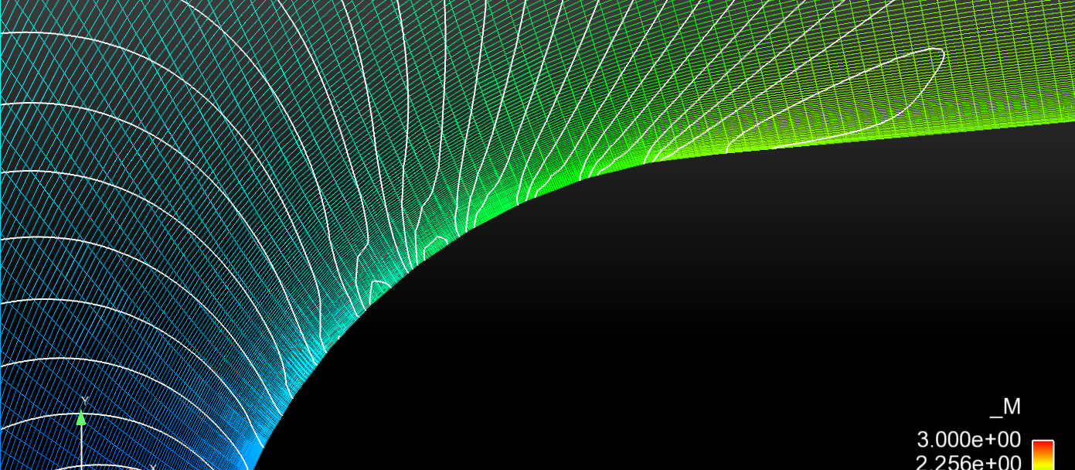
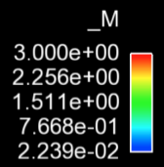
Geometry Snapping with Refinement
Notes:
Effect of geometry conforming refinement versus no geometry. Smoothness of field approximation eliminates spurious jumps in derivatives at boundary.
Note: geometry was generated from the mesh by fitting cubic splines and generating an OpenNURBS file (available in 2D only)

Slide 8
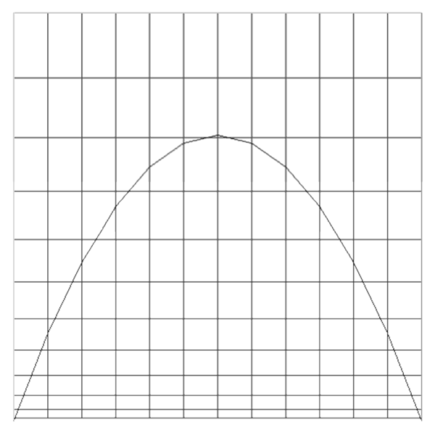
Smoothing and element detangling
Provide parallel shape/size improvement
Smoothing can work in tandem with CAD geometry
Respect any initial grading present in the mesh during subsequent refinements
Example: extreme perturbation of boundary by curved geometry.

Slide 9
Dynamic Mesh Adaptivity

Slide 10
Dynamic Mesh Adaptivity
Goal: optimize mesh through local refinement and un-refinement to minimize error for given computer budget
Activate an error indicator (How is the error distributed?)
Error-based: error in solution gradients
Feature-based: vorticity, flux limiters, within block/region
Specify how much refinement to allow
Frequency, iterations, growth in number of elements
Example applications using Percept:
Aria (Sierra Framework-based)
Nalu/Aero (STK-based)

Slide 11
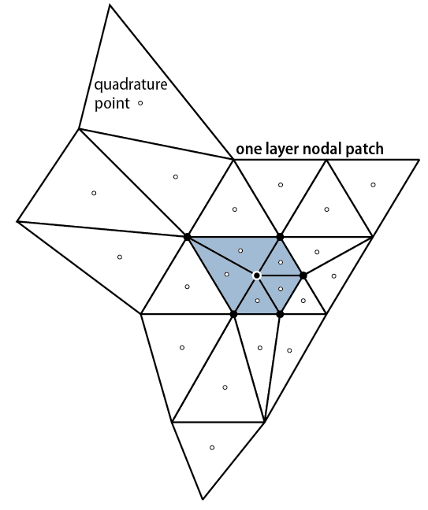
Why Conforming Meshes?
Sierra Framework: hanging nodes
Isotropically refined element shape no worse than uniform mesh refinement (UMR)
Constraint degrees of freedom don’t add any information to the solution
Constraints in solvers did not scale
Resulting ExodusII file is not a valid input mesh
Complex nodal patches (dual mesh, project.)
Percept: conforming meshes
Element quality degrades by at most half
Robust parallel iteration only involves element field quantities
Simple nodal patches, simple ExodusII files, valid for input into Sierra or visualizer
Applicable to simplex-type elements (Tri, Tet)
Also applicable to Quad/Hex/Prism/hybrid meshes with use of hybrid meshes

Slide 12
Transition Element Approach
1.
2.
Secondary (transition) elements
Primary (marked for refine)
Second Level Marking
3.
4.
Second Level Refine
Hanging nodes
(temporary)

Slide 13
Transition Element Algorithm
Algorithm has strong, testable guarantees of correctness
Ensure every TE is not next to an element marked for refine
Enforces no transition element can be refined
Iterative enforcement only accessing field data, converges in < 10 iterations (empirical)
Mesh correctness is guaranteed before actual refinement.
Unrefinement is straightforward and avoids locking behavior
Successfully ran jet in crossflow case with 15M elements (Chama 160 and 1600 cores)

Slide 14
Transition Elements Algorithm
Transition elements
Element marked for refine
Converged marking pattern (parents of TE’s marked for refine)
New mesh

Slide 15
Examples of Dynamic Adaptivity in Sierra Thermal Fluids Applications

Slide 16
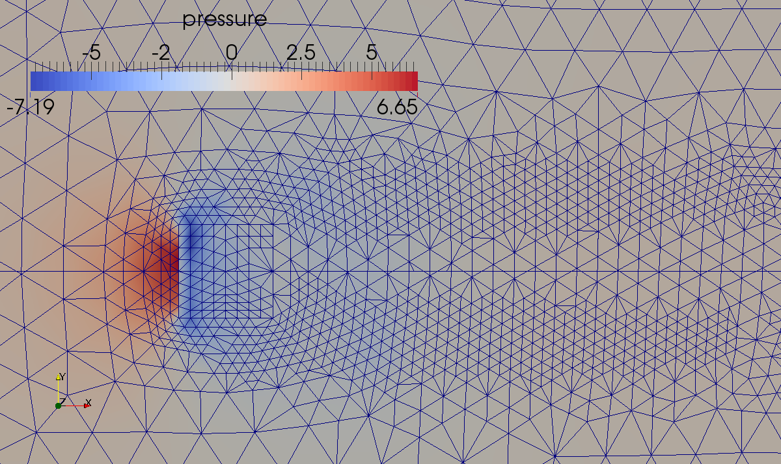
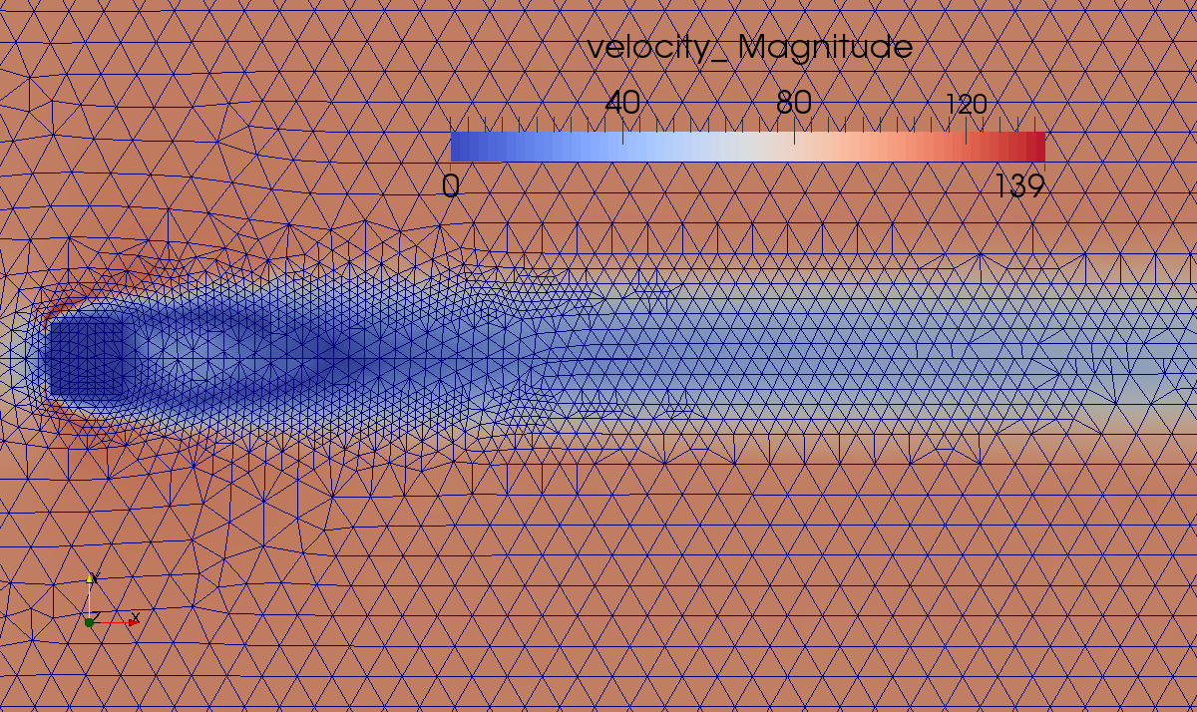
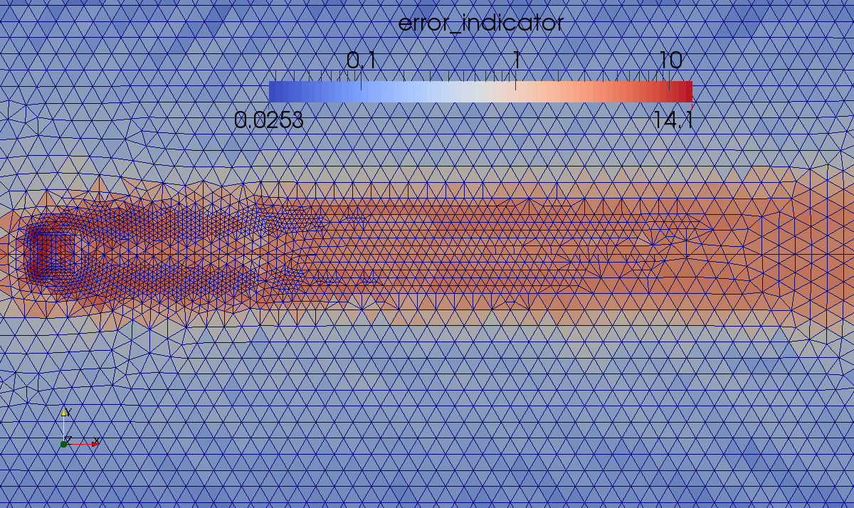
Example: Nalu (3D Tet)
Laminar flow past cube
Compare both edge- and element-based algorithms
Both Epetra and Tpetra
Error indicator is vorticity
Refine where vorticity is large
Elem: Tpetra
Edge: Epetra

Slide 17
Nalu: Jet in Cross-flow (2D Tri)

Slide 18
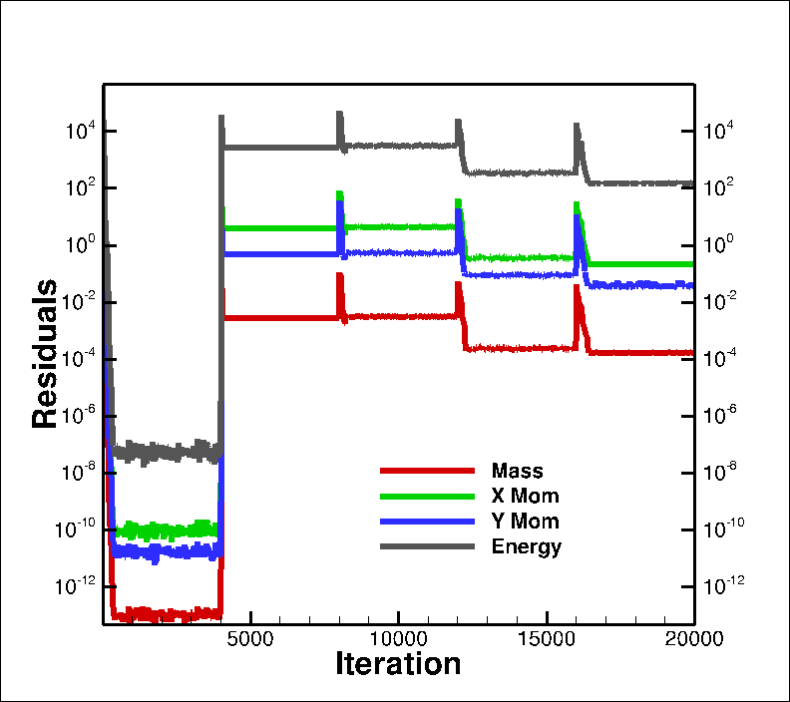
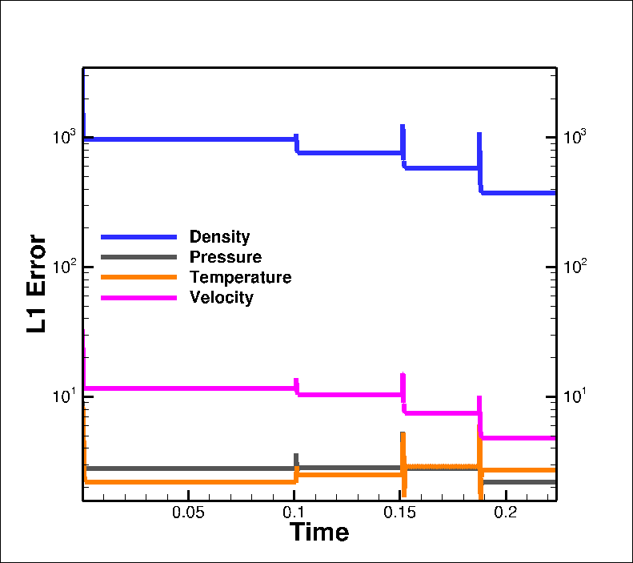
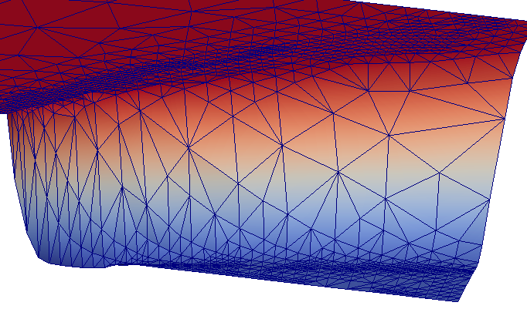
Example: Aero
Prandtl-Meyer inviscid supersonic expansion fan (based on verification test)
Using nodal Venkat limiter as error indicator – see some error reduction
Adapt every 4K iterations
See residual/error spike after adaptivity
Oblique shock test w/similar results
Residuals
Density contour plot w/mesh
L1 Errors

Slide 19
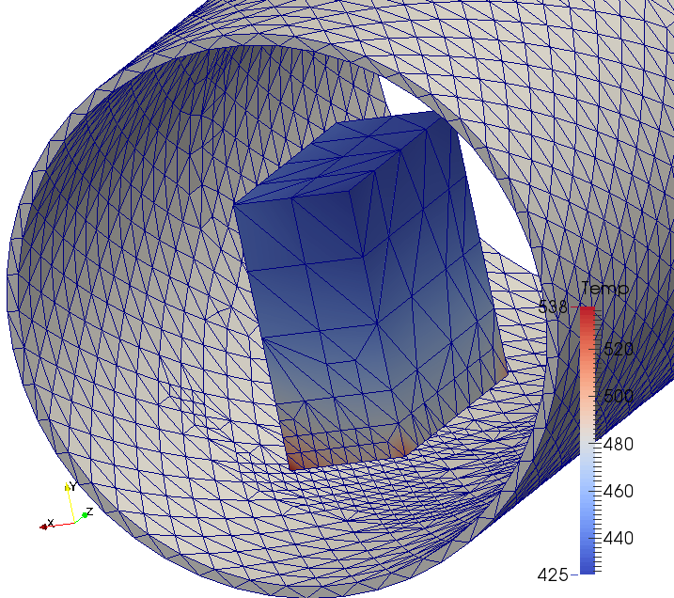
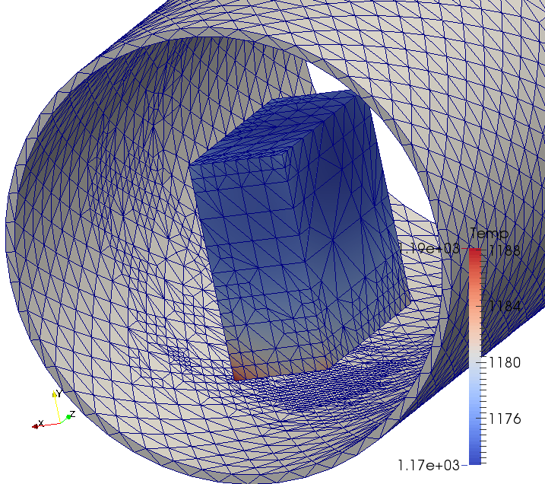
Example: Aria Thermal
3D thermal heat conduction with radiative forcing (tet mesh)
Quantities of Interest are min/max/avg/point value of T
Error indicator: error in grad T (using nodal patch recovery)
Marking strategy: many available, we used percent of max error
Adaptive strategy:
Refine every 40 time steps
Let adaptive time stepping set time step
To test for convergence:
Compare with UMR results
Increase max level of refinement (1,2,3,4)
Increase max number of elements (30K-100K)

Slide 20
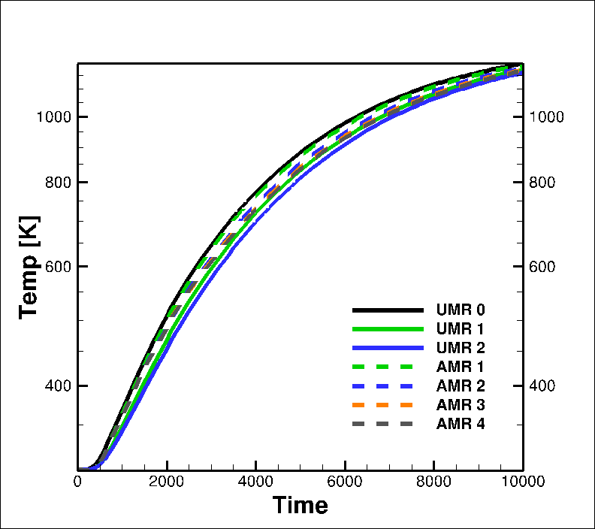
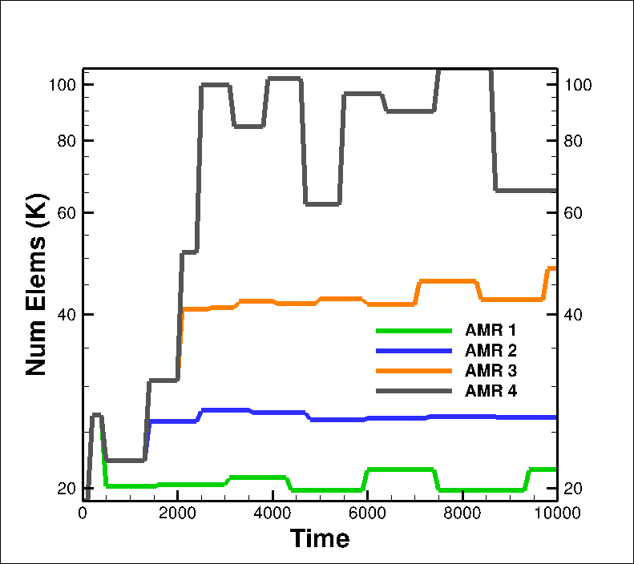
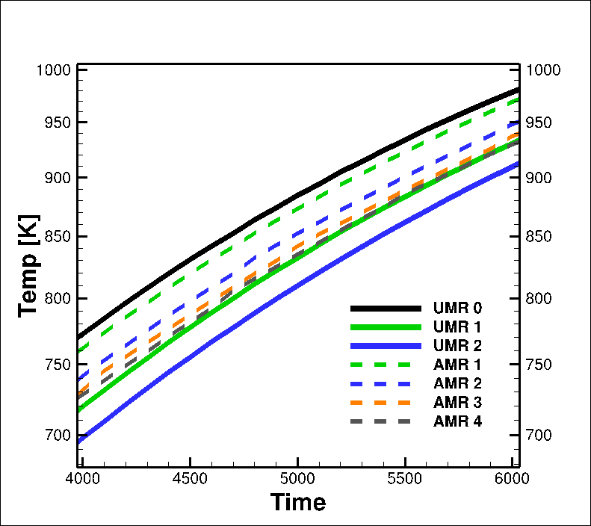
Results: Aria Thermal
The error indicator is not guaranteed to reduce the error in the QoIs
With proper control of the AMR, we are seeing convergence
Finest AMR result has about ~100K elements
This is less than the first UMR mesh (150K)
Second UMR mesh has 1.2M elements
Zoom to region

Slide 21
Offline Mesh Adaptivity

Slide 22
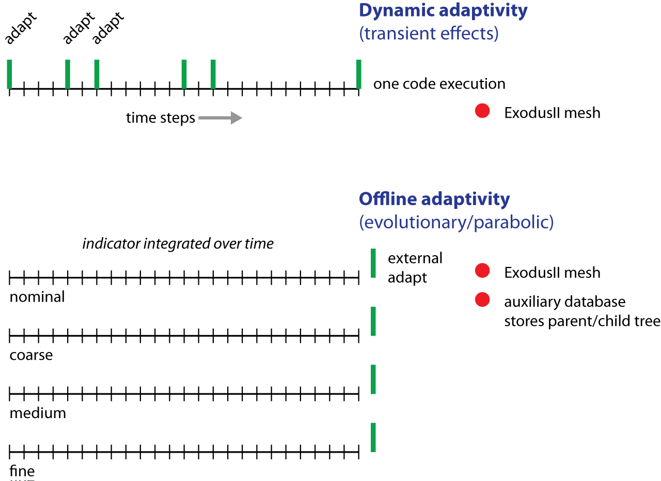
Offline Adaptivity Workflow

