Slide 1
Kokkos Kernels
Luc Berger-Vergiat, Siva Rajamanickam
V. Dang, N. Ellingwood, J. Foucar, B. Kelley, E. Harvey,
K. Liegeois, C. Pearson, E. Prudencio
Trilinos User Group meeting 2023
Albuquerque, New Mexico
SAND2023-11561PE

Slide 2
ECP / Sake updates

Slide 3
sake accomplishments
KPP-3 integrations:
  ATDM application integrations SPARC and EMPIRE
    Focused on features for solvers and preconditioners on AMD platforms (BlockTriDiag, ILU, Multigrid…)
    Supports application milestones
  ECP integrations
    Integration with Trilinos and PETSc
    Integration on AMD and Intel platforms
ALL KPP-3 are reviewed and approved by federal program manager
  Trilinos contributes 1pt to Math Libraries
  Kokkos Kernels contribute 0.5pt to Math Libraries, 0.5pt to ATDM
  Sake amongst the first math libraries project fully approved

Slide 4
Platform support

Slide 5
HIP Backend
HIP moves out of experimental in Kokkos 4.0.0
  Kokkos::Experimental::HIP becomes Kokkos::HIP
  Kokkos Kernels internal library clean-up
More rocBLAS/rocSPARSE coverage
  SpMV: single vector, multivector and block variants supported
  SpGEMM and block SpGEMM
  All Blas2/3 and most Blas1 supported
Stream support using Kokkos execution space

Slide 6
SYCL Backend
Still experimental, although more mature
Almost all tests passing on Ponte Vecchio (still issue with SpGEMM)
More TPL support of oneAPI MKL
Nightly testing of SYCL, should promote to CI once stable and if testing capacity allows
Integration with Trilinos and PETSc
Runs using ship_003 from SuiteSparse and Kokkos Kernels native SpMV

Slide 7
New features

Slide 8
General Library updates
Library reorganized by components
  Blas
  Batched dense/sparse
  Sparse
  Graph
  ODE (WIP)
Added oneMKL TPL
Kokkos Kernels version macros
  CMake: KokkosKernels_VERSION
  Header (KokkosKernels_config.h): KOKKOSKERNELS_VERSION

Slide 9
General Library updates
Google Benchmark TPL
  Enable with: KokkosKernels_ENABLE_TEST=ON + KokkosKernels_ENABLE_PerfTests=ON + KokkosKernels_ENABLE_Benchmarks=ON
Configuration output
  KokkosKernels::print_configuration(std::ostream&)
  Prints library version and TPL information
  Feedback welcomed on what additional information should be printed!

Slide 10
BLAS
Blas completeness
  Blas1 complete
  Blas2
    General/Symmetric matrix needs SYMV to be complete
    No packed/banded algo yet
  Blas3
    General/Symmetric: need SYMM, HEMM and rank k/2k updates
All Blas algorithms support stream execution
  KokkosBlas::myBlasKernel(space, …);
General maintenance of TPLs
  Added support for newer versions of cuBLAS/rocBLAS
  Working on oneMKL support for Intel GPUs

Slide 11
Sparse
Sparse format conversion
  coo2csr, csc2csr
Merged based SpMV for unbalanced rows in matrix
SpGEMM
  New “reuse” interface, saves graph of previous matrix
  Improved TPL support (MKL, cuSPARSE) new rocSPARSE support
Incomplete factorizations
  New parILUt algorithm (iterative computation of L and U)
  New MDF(0) algorithm (re-orders following Frobenius norm of discard factor on the fly)
  Stream version of ILU(k) and SpTRSV

Slide 12
Sparse
Brs format support
  Improved SpMV performance especially on AMD platform with TPLs
  Results below: 1 vector, block size = 7, rocm 5.2.0
CrsMatrix sort and merge
  Needed for some TPL
  Useful after SpGEMM and or MPI communication

Slide 13
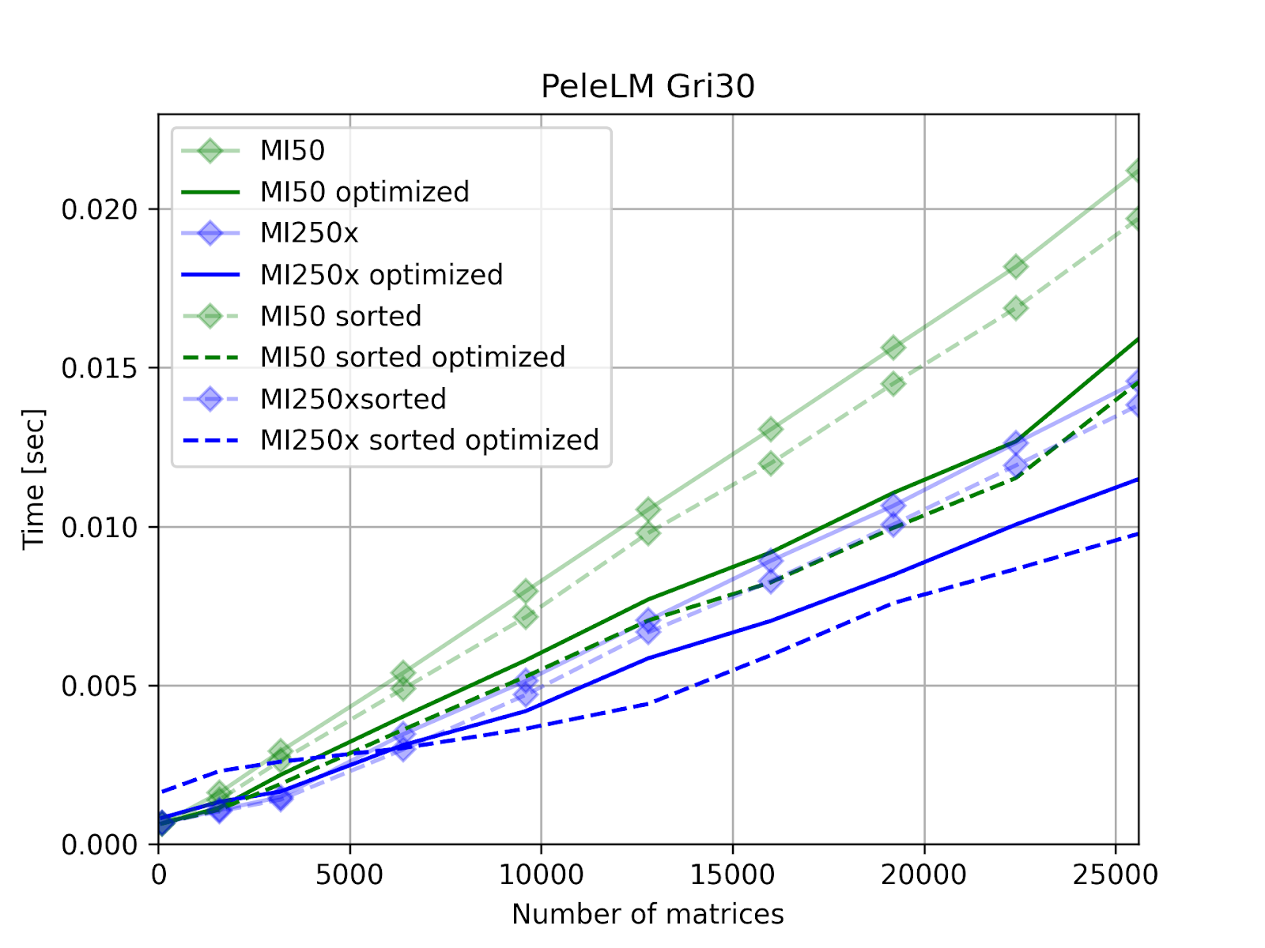
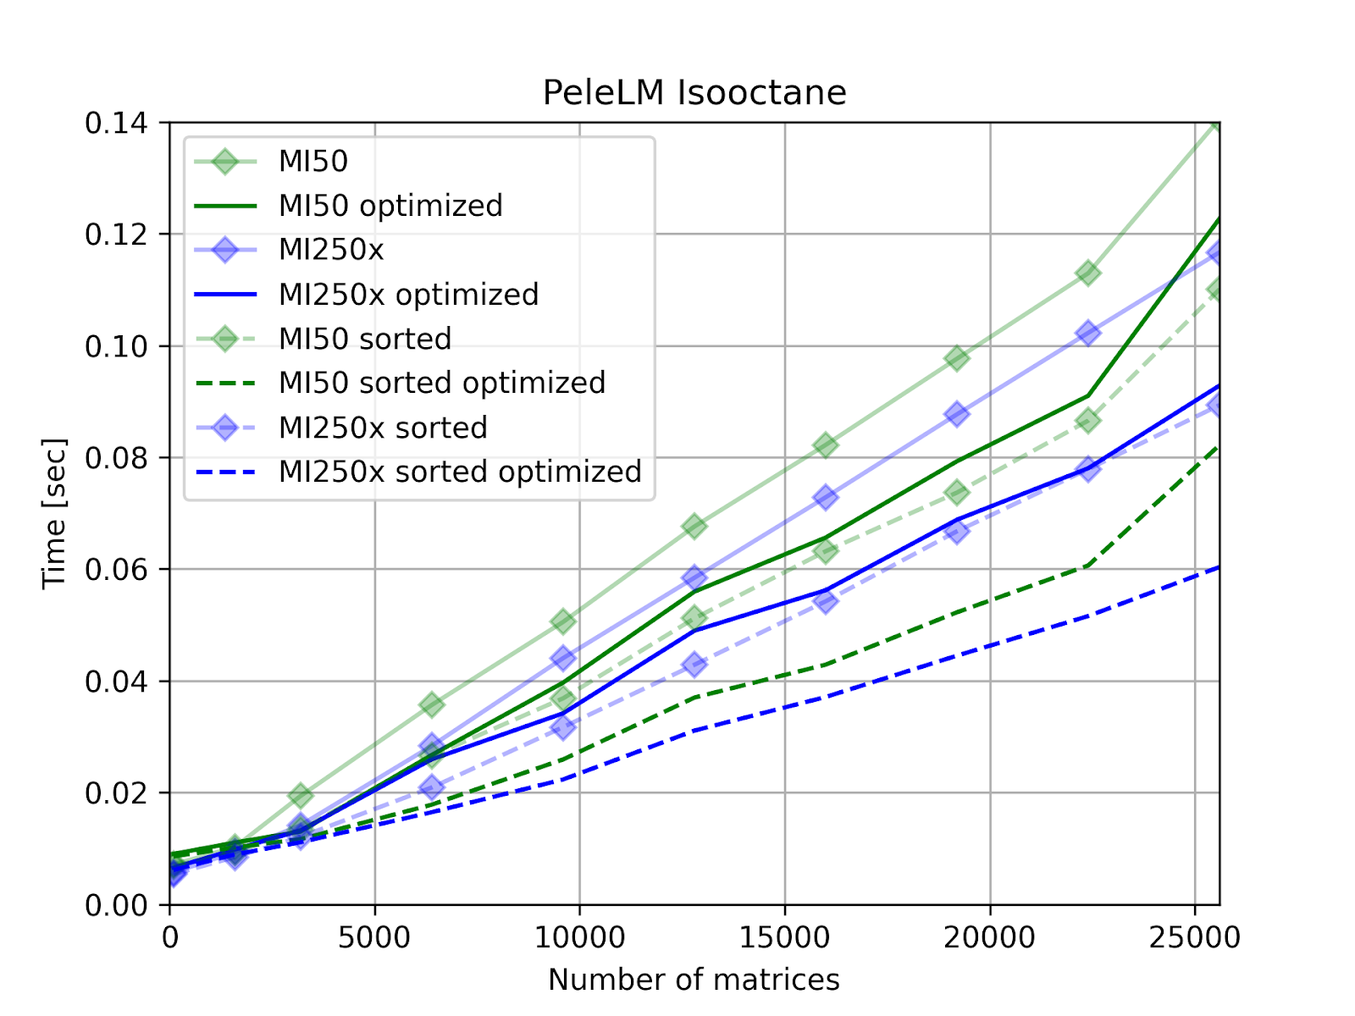
Batched
Sparse Batched algorithms
Algorithms implemented:
  Linear algebra (SpMV)
  Iterative solvers (CG, GMRES)
  Preconditioner (Jacobi)
Launch parameters tunned for architecture
  NVIDIA V100
  AMD MI50 / MI250

Slide 14
ODE
New component for time integration algorithms
Explicit integrators
  Runge Kutta (orders 1 to 5)
  Various schemes for stability (Fehlberg 45, Cash-Karp, Dormand-Prince)
  Time adaptive
Implementation for GPU work within a RangePolicy
Num systems | 10,000 | 100,000 | 1,000,000
CTS-1 | 3.17128 | 31.709 | N/A
ATS-2 | 0.0303719 | 0.365714 | 2.33355

Slide 15
Release 4.2.0

Slide 16
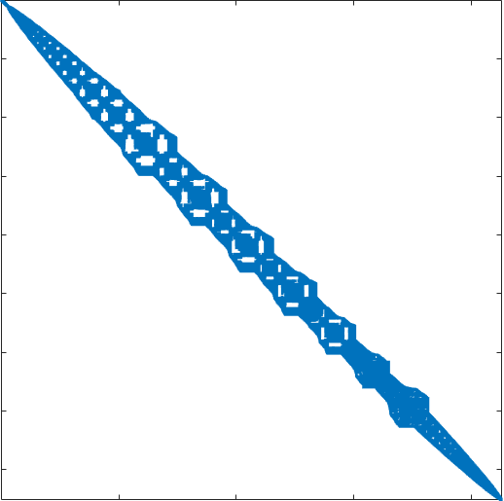
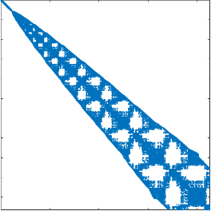
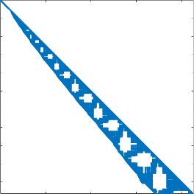
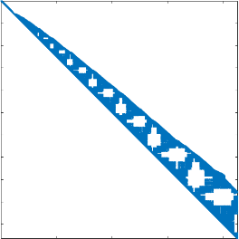
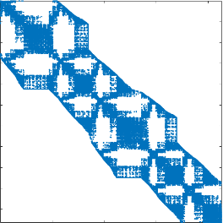
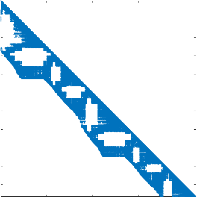
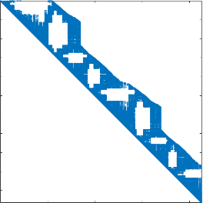
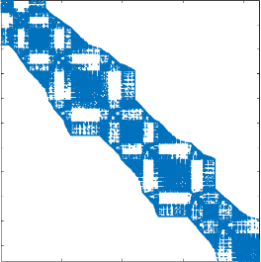
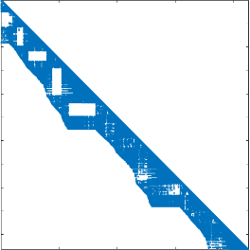
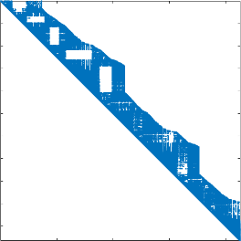
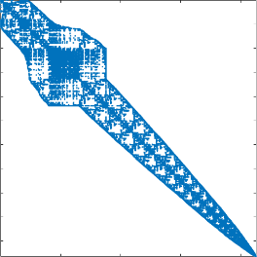
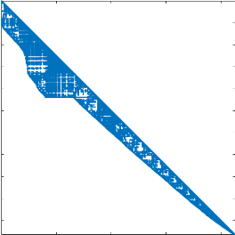
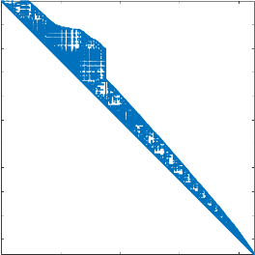
Stream based sparse preconditioners
Stream Gauss-Seidel
Stream ILU(k)/SpTRSV
  Decompose the problem as we would with MPI
  Use a stream per subdomain
Local MPI rank matrix
Stream split matrices
Stream split factors

Slide 17
Stream based ILU(K)
Scaling study 1 to 8 streams
  Good scaling overall
  Some scalability loss in SpTRSV on 8 streams
  Performance very dependent on CUDA version (results obtained with CUDA 11.8)
Like MPI partitioning, balancing is important!

Slide 18
ODE
Newton solver
  Drive adaptation from convergence behavior
  Cheaper secant variant option
BDF, implicit time integration
  Similar feature to CVODE
  Time and order adaptive
  Order 1 to 5
  Initial time step estimation
Best option for stiff problems see left

Slide 19
Upcoming work

Slide 20
Algorithmic development
Block-ILU(k) variant
  Fill based on block graph
  Integration with Ifpack2
LAPACK select algorithms implementation (LU, SVD, QR)
  Add new library component
  Include cuSOLVER, rocSOLVER, MKL and Magma TPLs
Improve BDF features:
  Numerical differentiation Jacobian
  Backtracking line search
Batched ODE solvers
  Reduce branch divergence on GPU
  Promote vectorization on CPU
  Potentially complicated for BDF, easier for RK algorithms

Slide 21
LIBRARY Improvements
SYCL backend: improve support and performance once Aurora comes online
Improve integration with Trilinos and PETSc
Establish automated performance testing
Improve interface to enable auto-tunning

Slide 22
acknowledgements
Jonathan Hu and Tom Ransegnola for contributing multiple integrations of incomplete factorizations in Ifpack2 and more…
Junchao Zhang for Kokkos Kernels/PETSc liaison, integration and contributing multiple TPL integrations and fixes
Victor Brunini for interfacing with applications, providing design and performance feedback on new features
Satish Balay and Sameer Shende for updating us on various incompatibilities and updates in Spack and xSDK
Mark Adams for all the discussions on the batched linear solver interfaces and performance
And to all the other contributors who help improved the library by providing feedback, documentation updates and bug fixes
We owe you a debt of gratitude, thank you for your continued support!

Slide 23
Any questions?

