Slide 1
Trilinos Performance Monitoring with Watchr
Brian Kelley & Chris Siefert
TUG 2023, November 1, 2023
Special Thanks: Elliott Ridgway for developing Watchr
SAND2023-11652PE

Slide 2
Performance Monitoring with Watchr
Watchr is an open-source Jenkins plugin developed at Sandia
Created and developed by Elliott Ridgway until FY24, carried on by Eric Ho (both 1424)
And installed on Sandia Jenkins instances (like jenkins-son.sandia.gov)
Adds a “Performance Reports” page to your build
Perfect for nightly performance data
x-axis is build date
y-axis is elapsed time
Teuchos::StackedTimer can output data in Watchr XML format

Slide 3
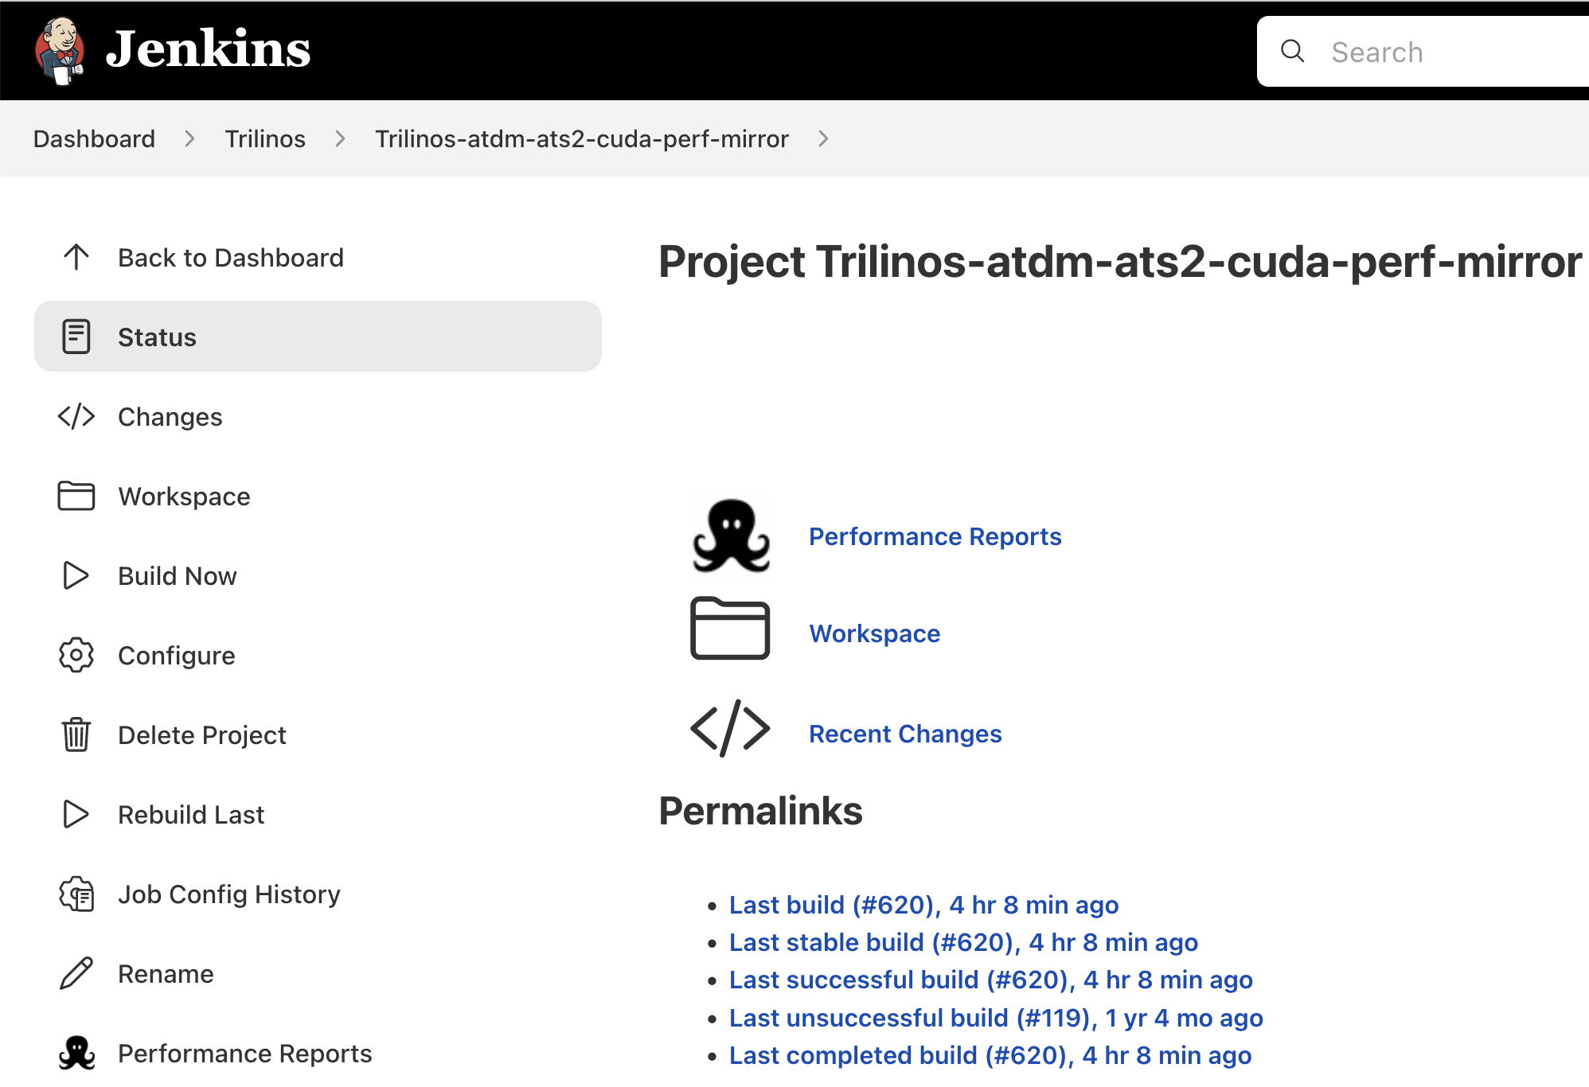
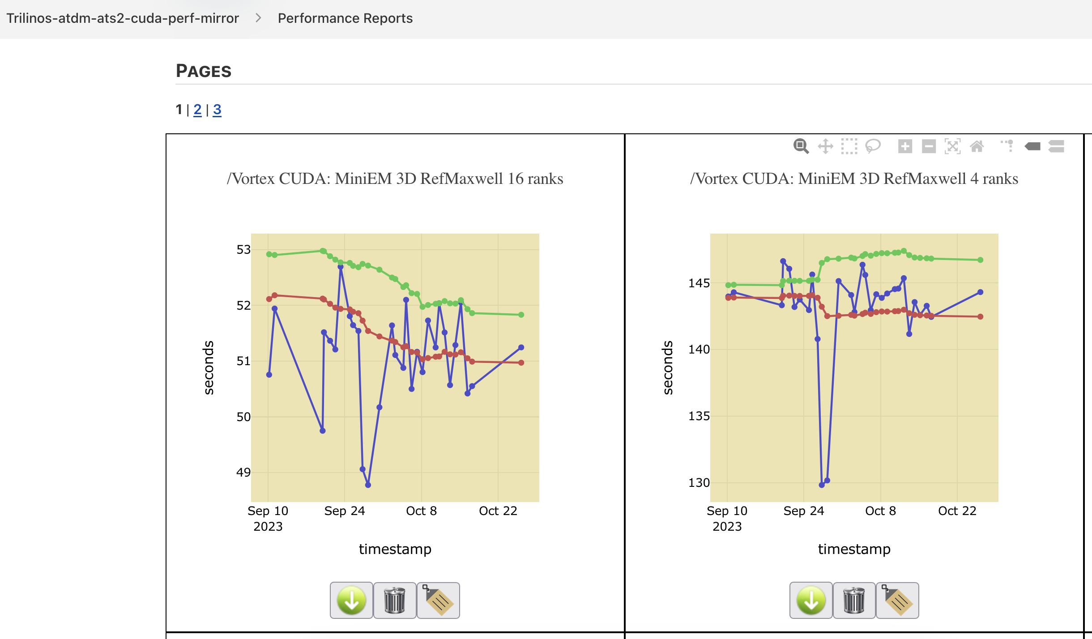
Performance Monitoring with Watchr
Moving avg+std dev
Moving avg
Time

Slide 4
Motivation
It’s useful to see how Trilinos code changes affect performance in different workloads
Changes can have unexpected impact, both positive and negative
There are several architectures whose performance we are interested in
Intel CPU: CTS-1 (Broadwell), CTS-2 (Sapphire Rapids)
GPU: ATS-2 (Nvidia V100), Crusher/Frontier (AMD MI250X)
And many different workloads, including:
Fundamental kernels like matrix-vector product (SpMV)
Specific linear systems from applications (SierraTF, SPARC)
MueLu multigrid setup and apply
Tpetra graph assembly
This work doesn’t reduce the amount of data, but it does let us assess performance at a glance and track down problematic changes
Mouse over a data point to see the build date and Trilinos version

Slide 5
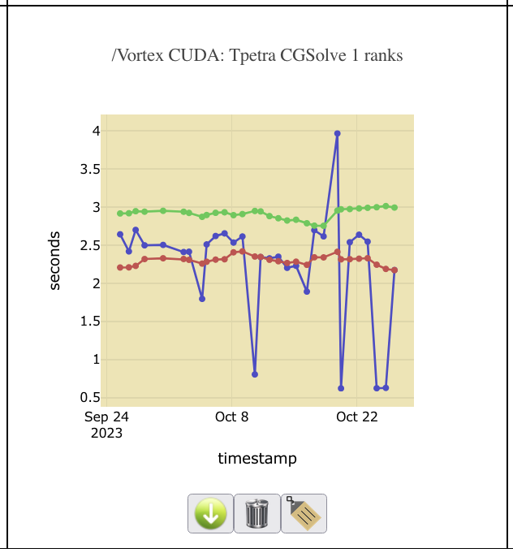
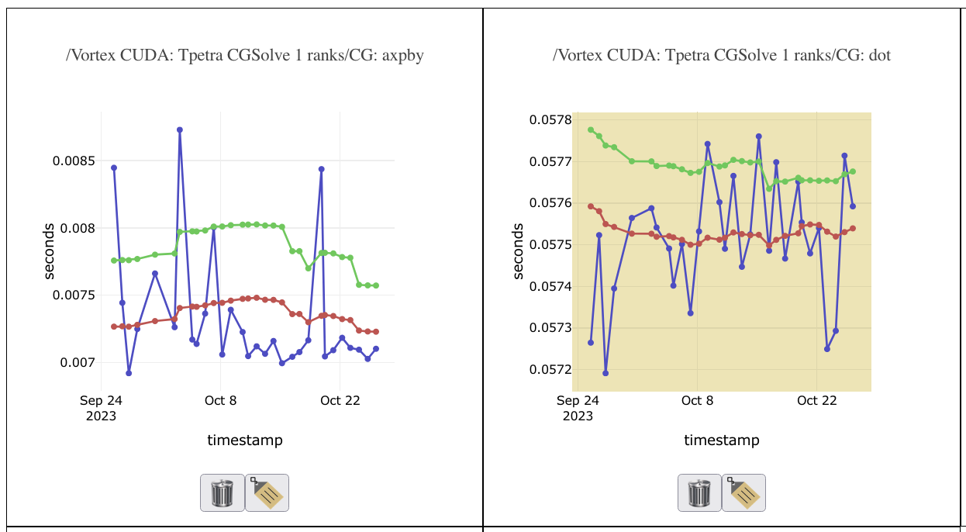
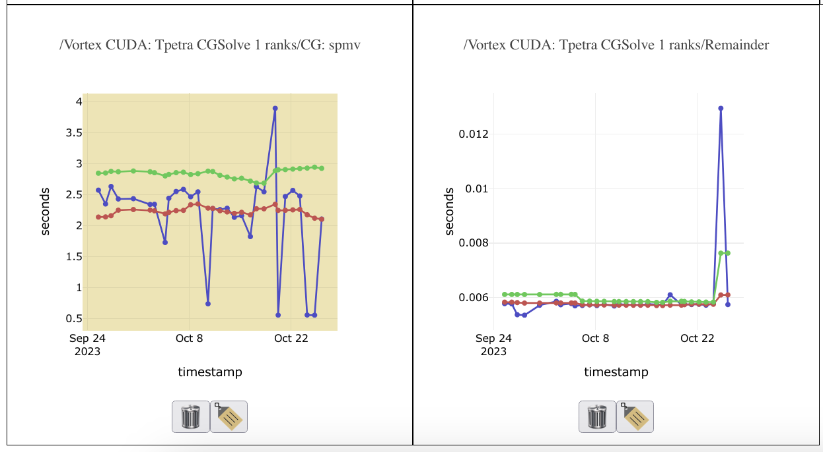
Watchr and Teuchos Stacked Timer
CG Solve
Watchr supports hierarchical data
Timers can have sub-timers
Just like Teuchos::StackedTimer
StackedTimer can output Watchr XML-formatted data
Real example: Tpetra CGSolve
Conjugate gradient calls smaller kernels:
axpby
dot
spmv
CG Solve/axpby
CG Solve/dot
CG Solve/spmv
CG Solve/Remainder

Slide 6
Generating Watchr Data
In code:
Use Teuchos::StackedTimer and Teuchos::TimeMonitor around code regions of interest
Call stackedTimer->reportWatchrXML("my benchmark", comm); to write Watchr XML
This has no effect if $WATCHR_PERF_DIR is not set (see below)
At runtime, set some environment variables
[Required] Set $WATCHR_PERF_DIR to the absolute path of where XML files should be saved
[Optional] Set $WATCHR_BUILD_NAME to a description of your build (e.g. “GCC+OpenMP”)
[Optional] Set $TRILINOS_GIT_SHA to the Trilinos version (run “git rev-parse HEAD”)

Slide 7
Adding Timers to Code
#include "Teuchos_TimeMonitor.hpp"
#include "Teuchos_StackedTimer.hpp”
int main() {
using Teuchos::RCP;
using Teuchos::TimeMonitor;
using Teuchos::StackedTimer;
// ... initialize MPI, Kokkos, Tpetra ...
// Create and activate the base StackedTimer. Its name does not appear in Watchr plots.
RCP<StackedTimer> timer = Teuchos::rcp(new StackedTimer("Global"));
TimeMonitor::setStackedTimer(timer);
{
// Create a scoped sub-timer
TimeMonitor t(*TimeMonitor::getNewTimer("Thing 1"));
doThing1();
}
doThing2();
timer->stopBaseTimer();
timer->reportWatchrXML(”My problem", comm); }

Slide 8
Running with an Existing driver
If your problem is a preconditioned linear solve (Belos + Ifpack2 or MueLu), configure Trilinos with:
-D Trilinos_TEST_CATEGORIES=”PERFORMANCE”
-D Trilinos_ENABLE_TESTS=ON
-D Trilinos_ENABLE_EXAMPLES=ON
and run a driver:
Ifpack2_tif_belos.exe <flags> --with_stacked_timer --problem-name=”solve1”
Iterative solver from Belos, with preconditioner from Ifpack2
MueLu_Driver.exe <flags> --stacked-timer
Iterative solver from Belos, with MueLu preconditioner and smoother(s) from Ifpack2

Slide 9
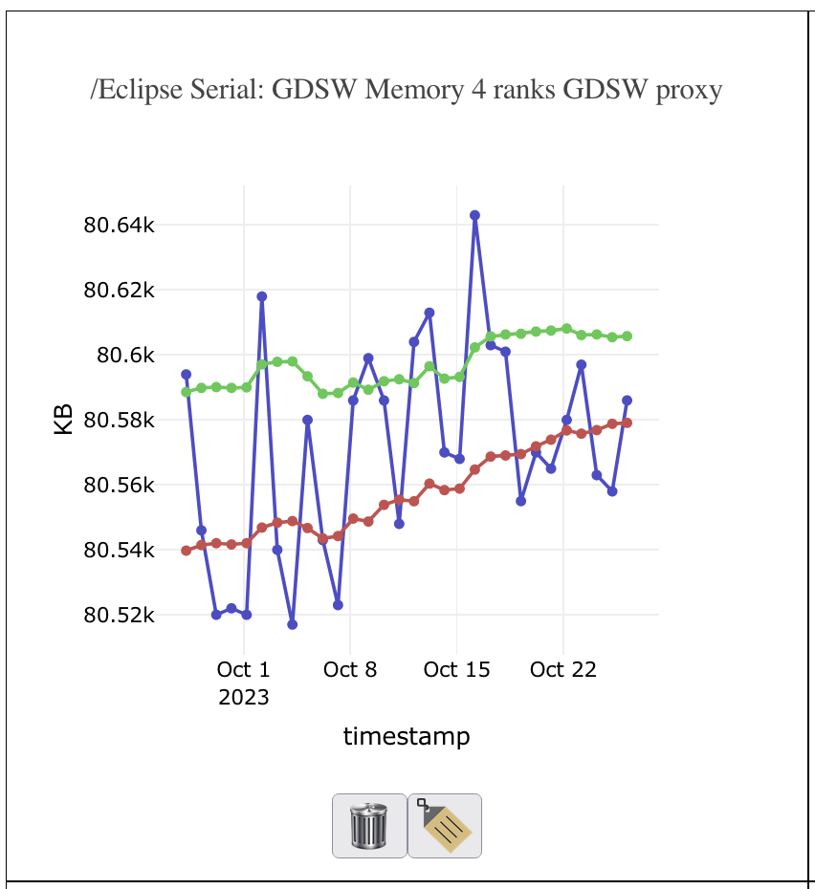
New Feature: Memory USAGE
Tpetra can now record and plot memory usage at certain point(s) in a program
Currently used on Tpetra matrix communication (import, export)
GDSW (two-level overlapping domain decomposition) setup
Will add to Belos+Ifpack2 problems soon
Eclipse: GDSW Memory 4 ranks

Slide 10
Currently Running Benchmarks
Panzer MiniEM
Belos CG solve with MueLu defaults on large 7-point stencil problem
Belos GMRES with Ifpack2 overlapping ILU(k)
Ifpack2 block tridiagonal apply
Distributed matrix-vector product (Tpetra::CrsMatrix::apply)
Distributed matrix-matrix product (TpetraExt::MatrixMatrix::Multiply)
Tpetra FECrsMatrix assembly
Communication patterns for GDSW preconditioner (measuring memory usage, not time)

Slide 11
Conclusion
Contact the Tpetra developers at tpetra-developers@software.sandia.gov
Watchr on GitHub: https://github.com/sandialabs/watchr-core
Main dashboard hosted on jenkins-son.sandia.gov
Only visible to Sandians
Actively monitored by Tpetra developers
As Trilinos package developers, we want to support application needs
We encourage apps to give us proxy problems to add to the nightly performance runs

Slide 12
Questions?
Contact the Tpetra developers at tpetra-developers@software.sandia.gov

