Slide 1
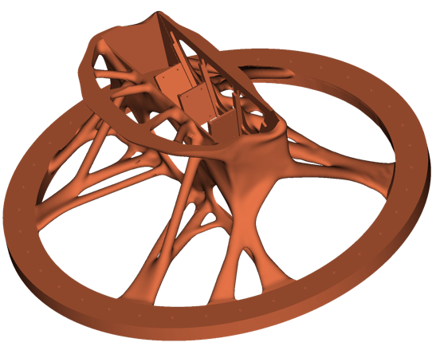
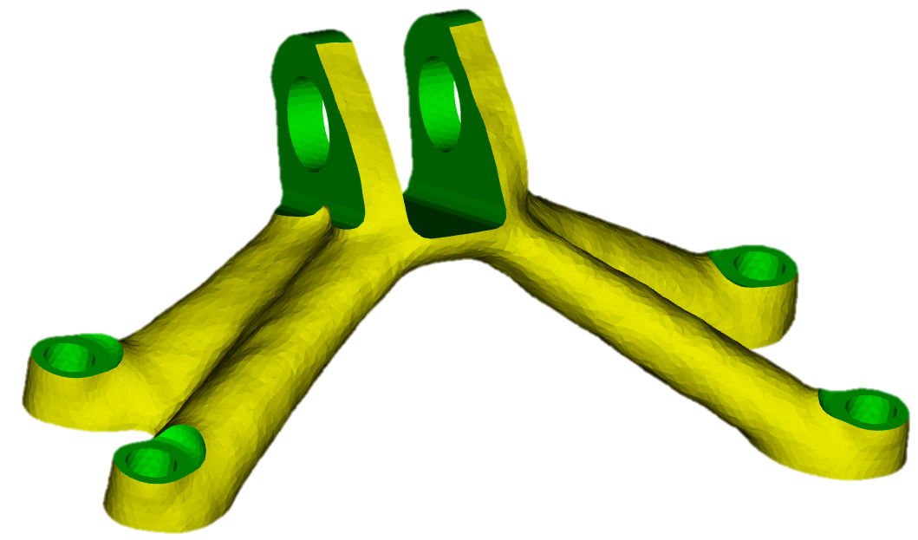
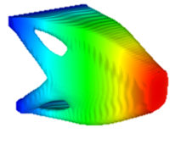
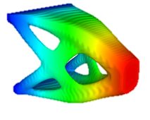
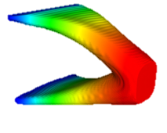
Plato optimization-based design
Trilinos User Group Meeting
Plato Software Development Team
November 1st, 2023

Slide 2
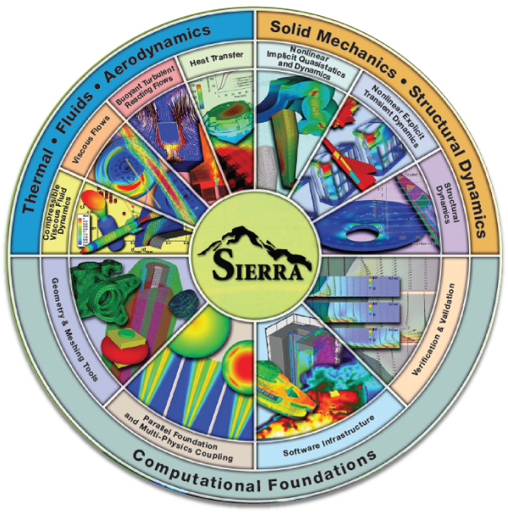
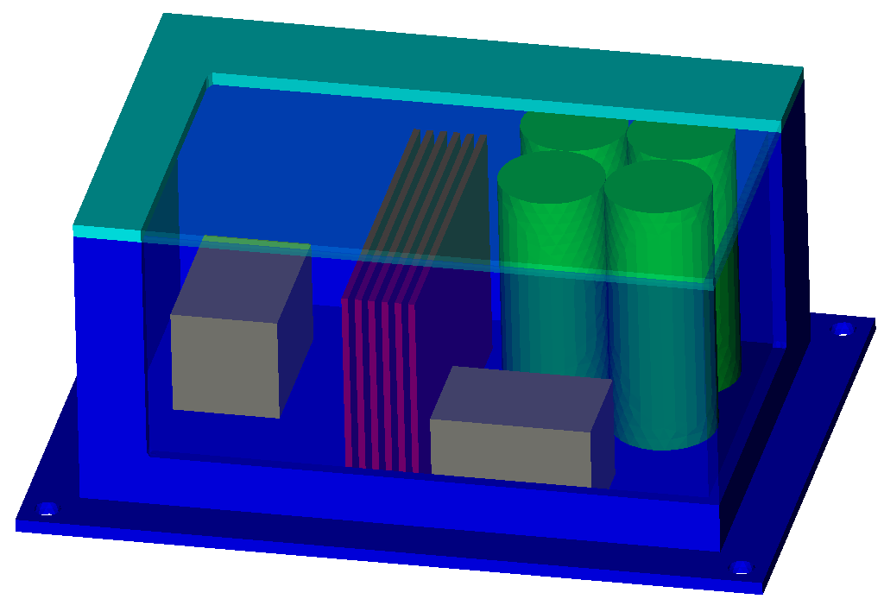
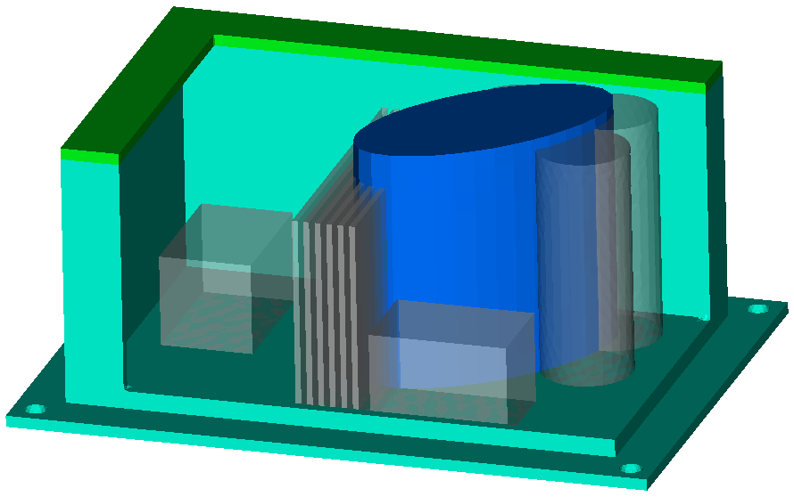
Plato: optimization-based geometry design
Gradient-Based Optimization
Strategy for automated design:
Quantify quality $f(x)$ of design $x$ via simulation
Formulate a mathematical optimization problem.
What Plato allows users to do:
Orchestrate the workflow
Use gradient-based methods
Automatically compose function evaluations across software packages for
Geometry
Meshing
Physics Simulation
Plato’s purpose at Sandia:
Platform for shape/topology optimization
Platform for continued research
Bread & butter: compliance min., stress-constrained mass min., mass mocks
$$m\text{in} f(x)$$
$$\text{s}\text{.}\text{t}\text{. }c\left(x\right)≤0$$
$$x$$
$$f\left(x\right), ∇f(x)$$
$$c\left(x\right), ∇c(x)$$
Shape
Topology
Mesh
Sierra Mechanics

Slide 3
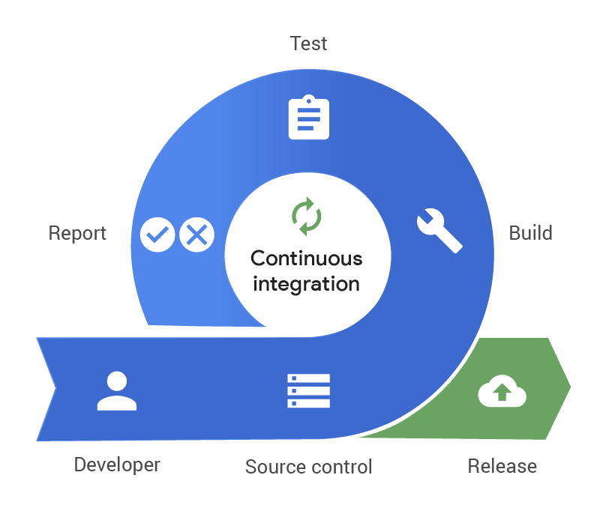
Plato: FY23 Q3 Noteworthy Items
HOW ARE YOU DELIVERING ON 1IC?
Production-ready thrust – improved build/test process integrated with Sierra, partnership with analysts
Incorporation of ROL’s stochastic optimization capabilities via V&V project
Ability to work with and connect to Sierra Mechanics
Plans to leverage 1540 UX/UI experience/capabilities
PERFORMANCE TO PLAN HIGHLIGHTS:
Removal of Plato’s legacy optimizers completed. This offers access to new algorithms and reduces our code maintenance burden through removal of 64k+ lines of code!
Joshua Robbins putting together EDC demonstrator for mass property shape optimization based on SD Modal tool functionality
Full continuous integration with merge gating enabled for Plato! Easier to use Sierra with Plato and substantially improves Plato’s code credibility moving forward.
Removal of legacy Plato
Optimizer and
full use of ROL
+
Has resulted in these advantages:
Removed 64K lines of code & technical debt!
Reduced maintenance burden
Increased code sharing
ROL is only gradient-based optimizer available in Plato
Over 64K lines of code deleted!
With help of DevOps, Plato is now on SRN under Continuous Integration
Has resulted in these advantages:
More secure development
Closer integration with Sierra
Closer integration with FuSED
Vastly improve code quality
Always in a releasable state

Slide 4
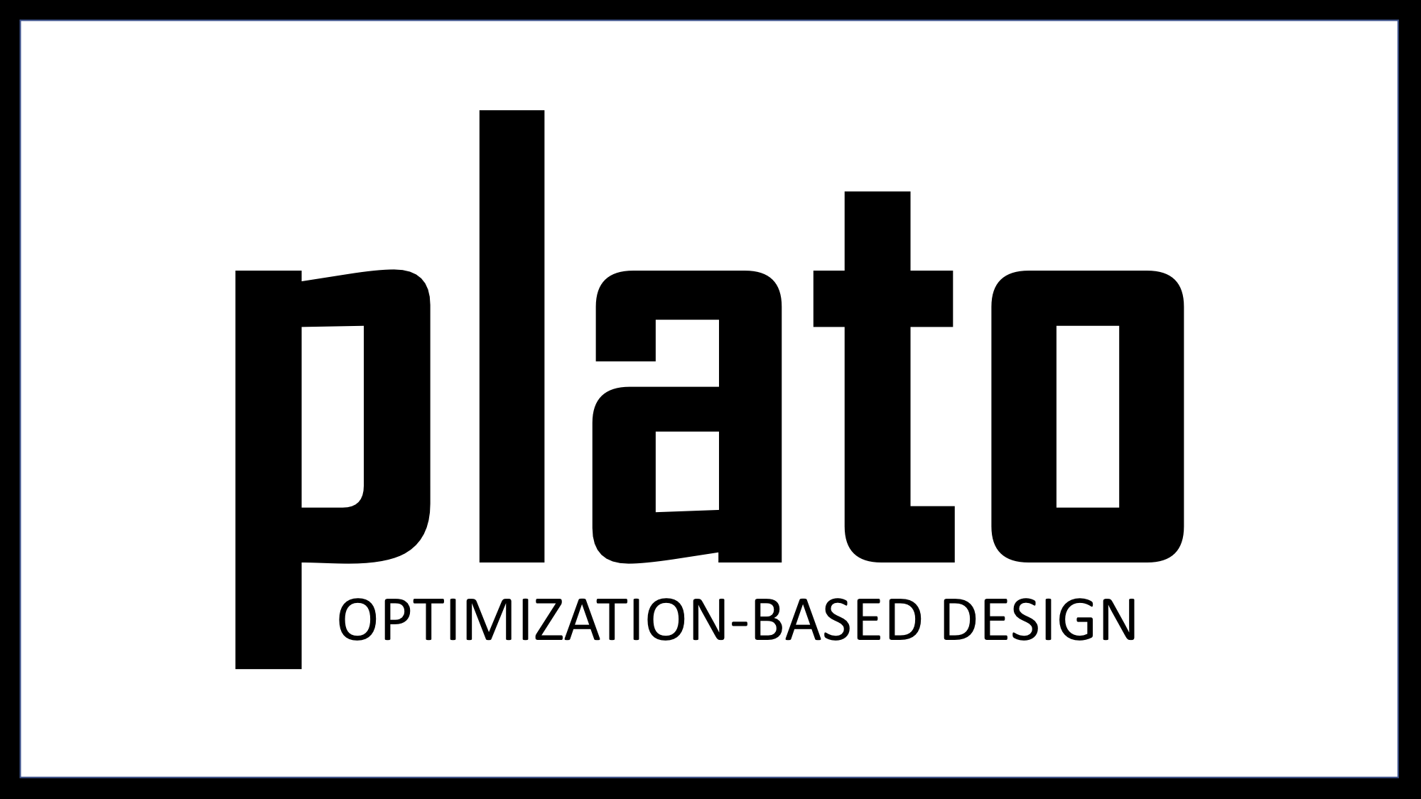
Hook up Tacho Solver
Customer: ASC/Plato
Purpose:
Epic Goal: Enable Plato Analyze use of ShyLU_Node solver Tacho
Sprint Goal: Plato interface is completed, Tacho is solving problems
Impact:
High-performance cross-platform shared-memory linear solver available in Plato
More robust testing, CPU-based testing
Performance improvements?
Notes:
Sean

Slide 5
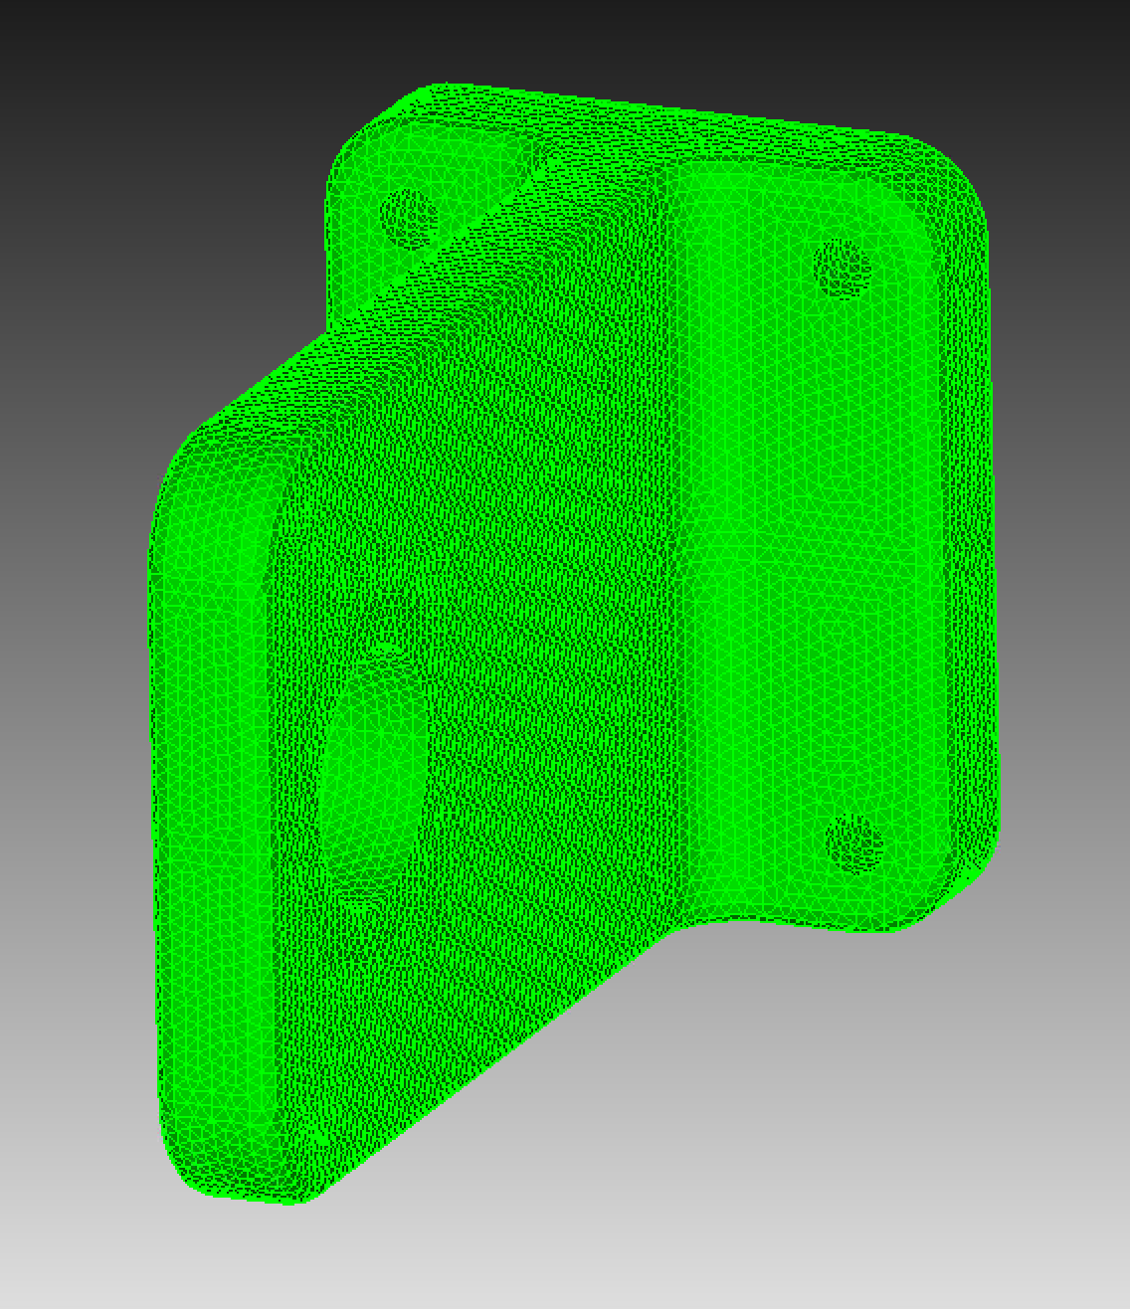
Hook up Tacho Solver
Instead of a few days’ effort, this turned into a two-sprint odyssey.
Thanks for your help:
Clark Dohrmann – lending us his interface
Kyungjoo Kim – helping us compile it
Christian Trott – helped us update to newer version of Kokkos
Notes:
Sean

Slide 6
Hook up Tacho Solver
Timing comparison with AmgX (@ 1e-12) on compliance minimization problem
DOFs | Tacho runtime (forward solve) | AmgX runtime (forward solve) | Tacho runtime (optimization) | AmgX runtime (optimization)
10245 | 14 s | 15 s | 11 s | 18 s
86559 | 12 s | 16 s | 29 s | 35 s
195357 | 14 s | 16 s | 53 s | 91 s
626409 | 36 s | 19 s | 170 s | 136 s
931500 | 50 s (14 GB mem) | 22 s | 252 s | 191 s
1470714 | Out of memory | 26 s | Out of memory | 300 s
4857837 | Out of memory | Out of memory | Out of memory | Out of memory
Notes:
Sean

Slide 7
Hook up Tacho Solver
Large startup cost obscures behavior for small problem sizes
AmgX scales better for large problems, as expected
GPU build of Tacho limited by 32-bit integer indices (this is a choice), device memory.
Tacho amortizes symbolic factorization cost significantly: subsequent solves in optimization loop much quicker than the first
To try:
Tacho multi-core CPU builds on larger systems (no device memory limit)
Tacho with higher-order elements (AmgX struggles)
Notes:
Sean

Slide 8
Hook up Tacho Solver
Timing comparison with AmgX (@ 1e-12) on orthotropic compliance minimization problem (poorly conditioned linear system)
DOFs | Tacho runtime (optimization) | AmgX runtime (optimization)
32448 | 21 s | 102 s
Summary
Tacho is faster for up to a few hundred thousand DOFs
Tacho is faster and more robust for poorly-conditioned systems
Tacho works on CPUs and non-nVidia hardware
We will default to Tacho but keep AmgX
We will delete our interface to Epetra-based solvers
Notes:
Sean

Slide 9
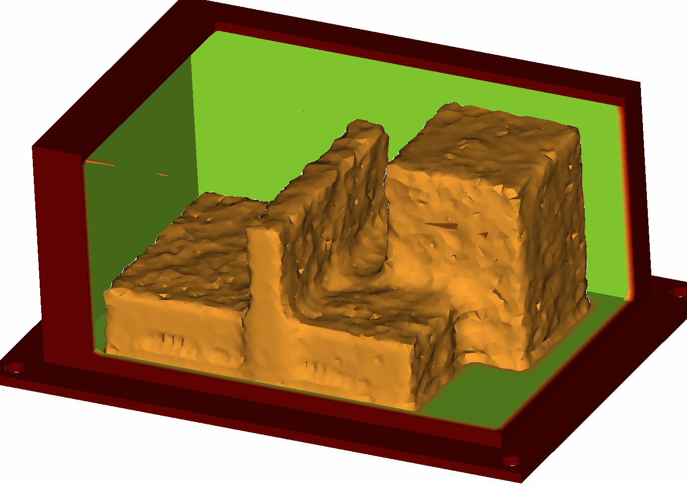
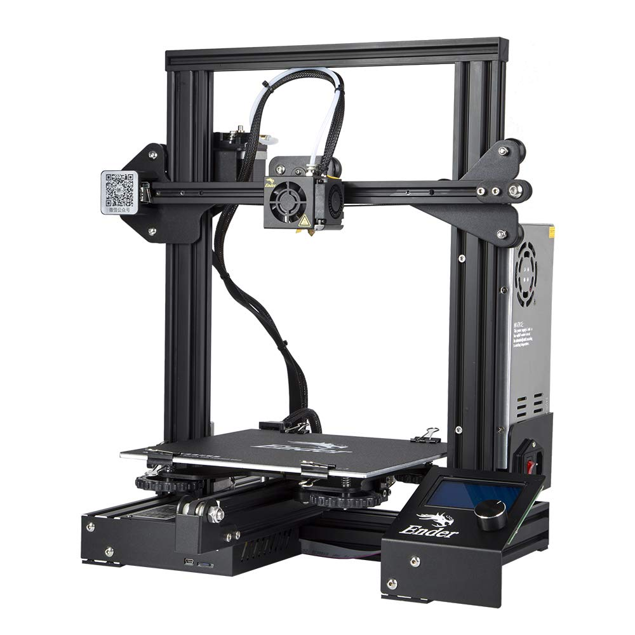
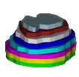
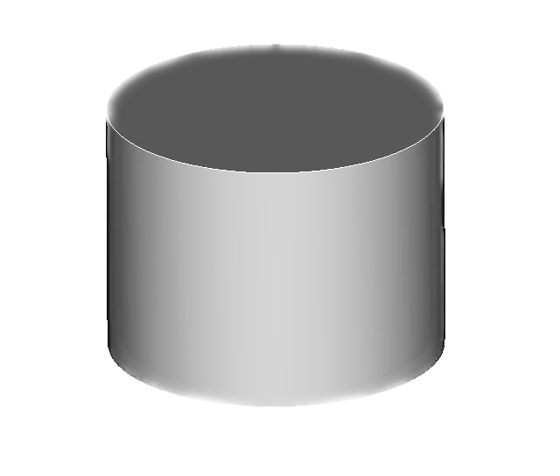
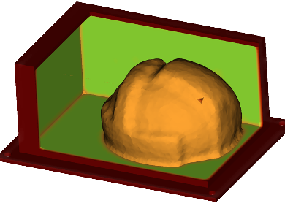
Mass mock design
EDC Demonstrator
CAD
Topology Optimization
Rapid interrogation of target properties
Material downselect
Inspiration
Shape Optimization
Dialing it in
EDC demonstrator
shape optimization of mass properties
web-based UI components
Shape Optimization
SGM
Target
Topology Optimization
Machining
Additive Manufacturing

Slide 10
Long-term Vision for Matching Dynamics (FY24+)
User-friendly tools for mass/dynamic mock design and fixture design that drive development of UI/UX components and connection to DEE.
Automatic conversion of CAD to simplified CSG (SGM)
Mass-properties-aware simplification
Improved numerical algorithms (Sierra/SD)
Shape sensitivity for shells and contact; investigate MPE sensitivity
Great opportunity to refactor and clean up Plato-SD interface
Improved problem formulation (FuSED/ROL)
Optimal selection of measurement locations
Generalization measurement operators to account for experimental data.
Level-set Methods for Topology Optimization (LDRDs: Alberdi, Dugger)
Necessary to get good solutions with dynamic physics

Slide 11
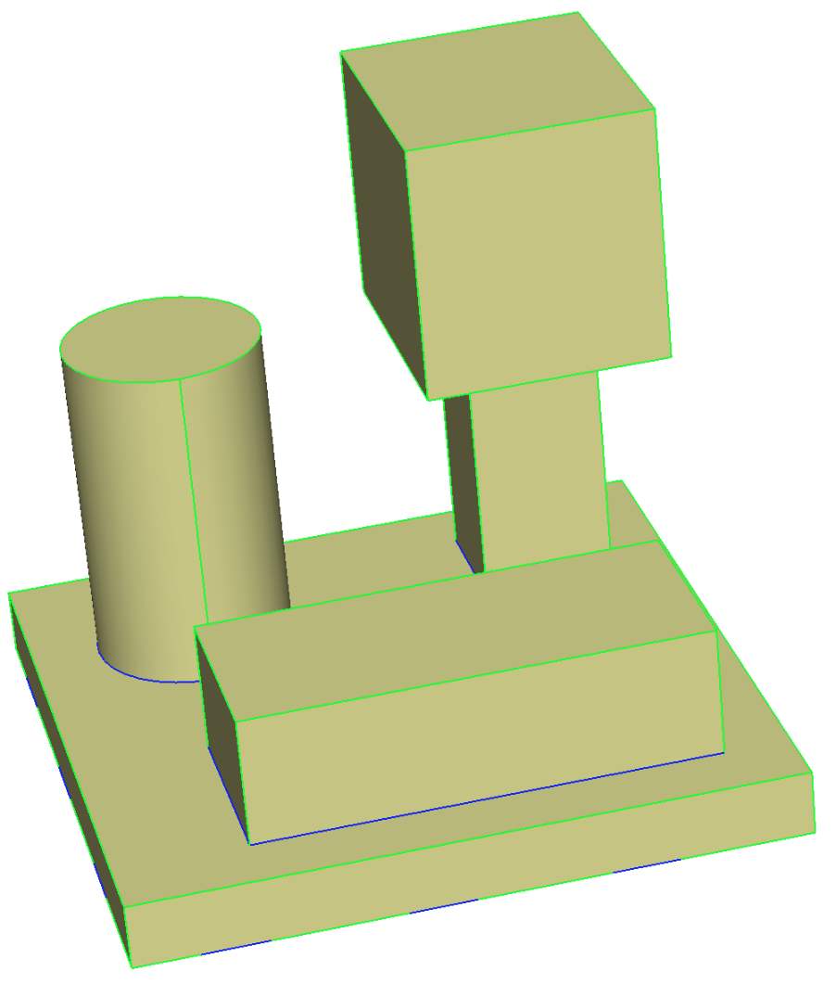
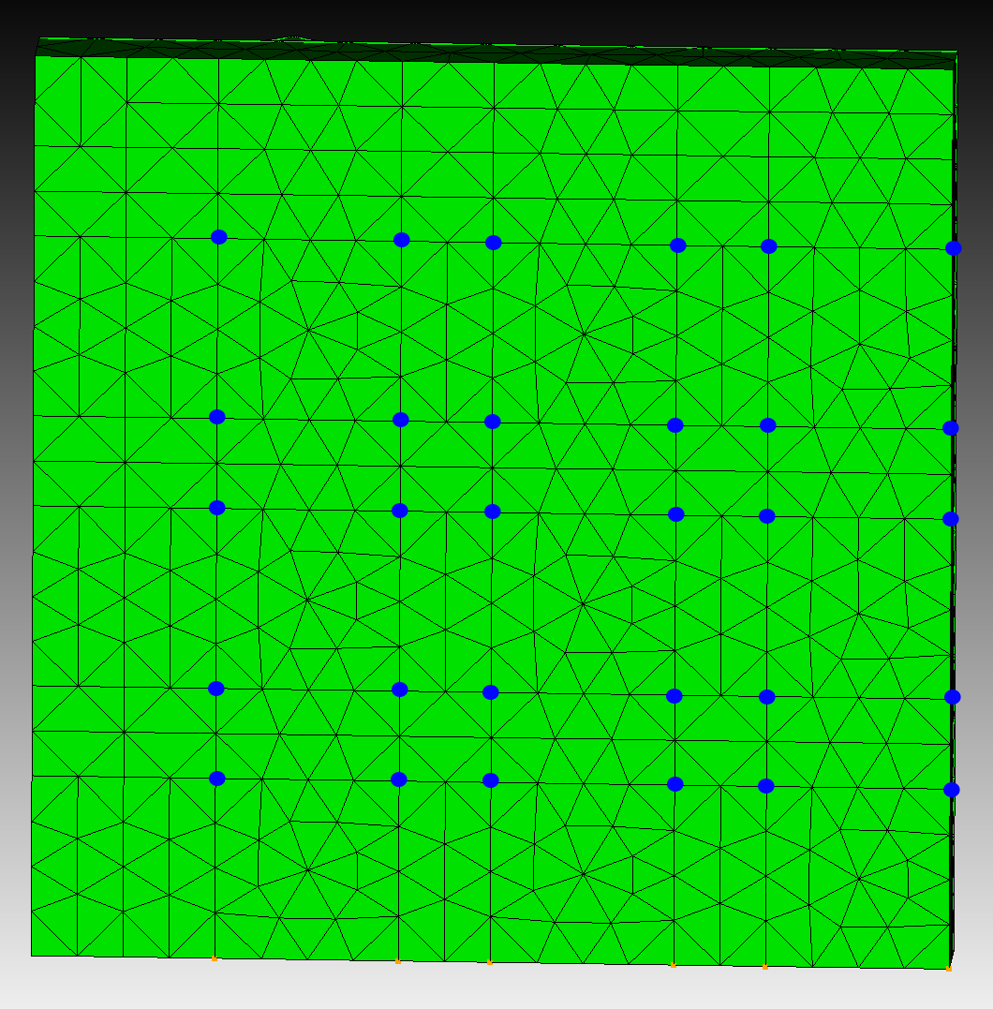
Mass Mock Modal Matching
Modes measured at blue dots on the bottom of the geometry
Notes:
Ryan

Slide 12
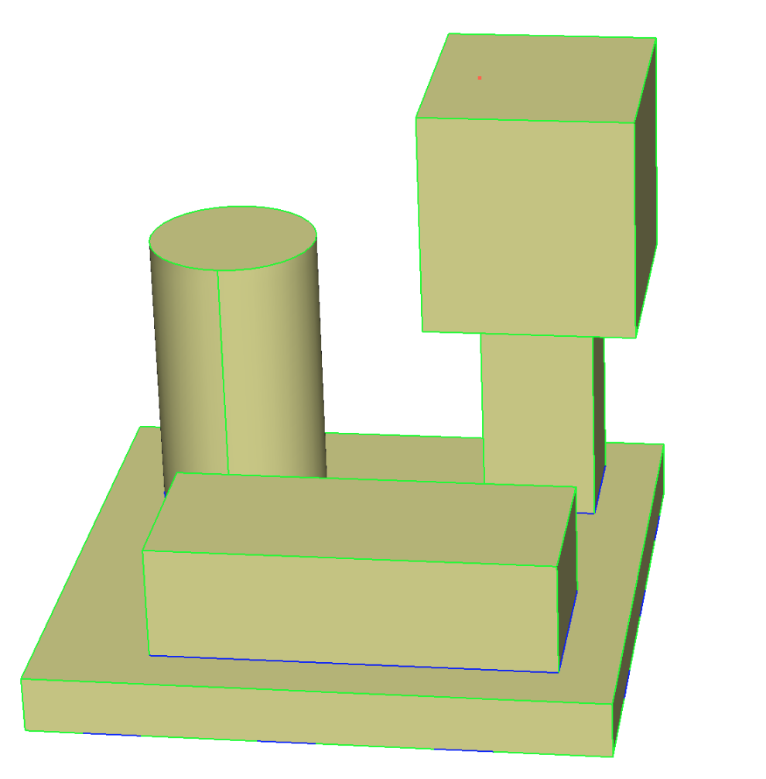
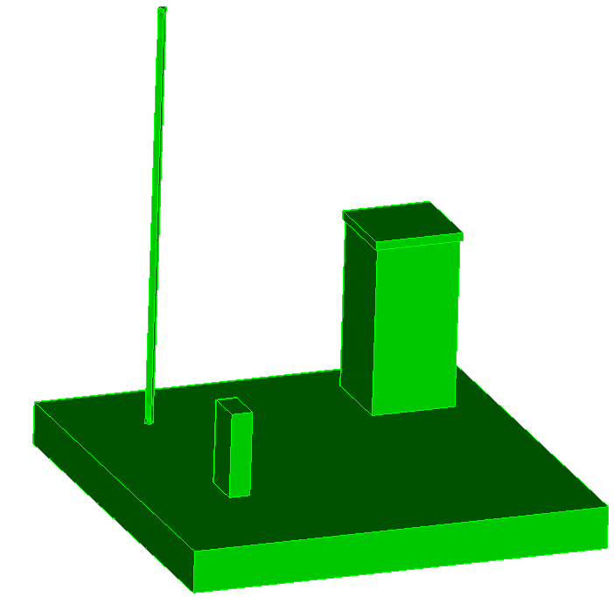
Mass Mock Modal Matching
Initial
Gold
Notes:
Ryan

Slide 13
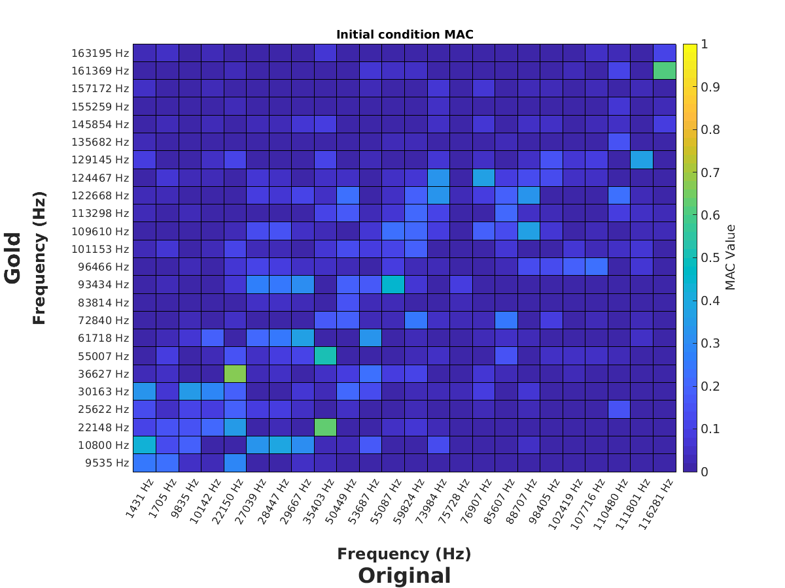
Modal assurance criterion (mac)
Notes:
Ryan

Slide 14
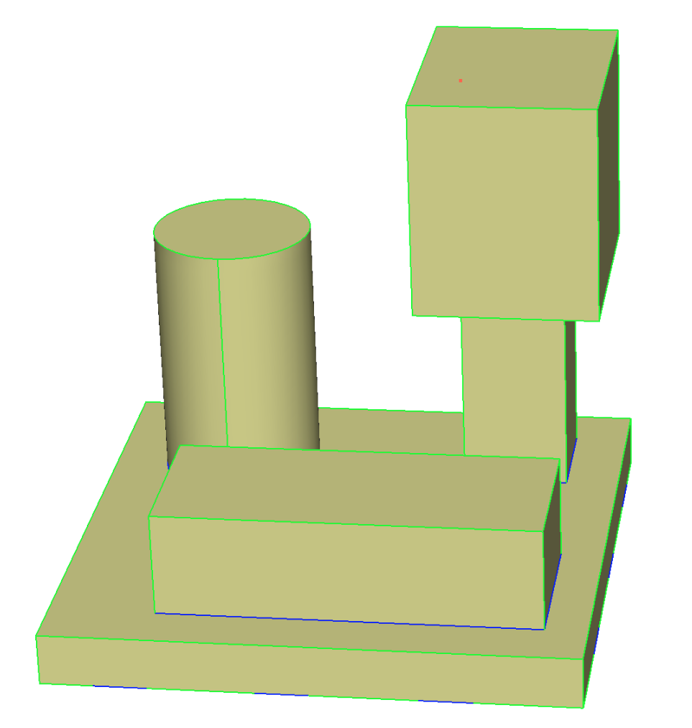
Mass Mock Modal Matching
Gold | Optimized
2.5 | 2.522263
2.5 | 2.506502
5 | 4.997805
1.5 | 1.519576
4.25 | 4.315312
4 | 4.255144
3.75 | 3.547251
3 | 2.966192
7 | 7.199514
Notes:
Ryan

Slide 15
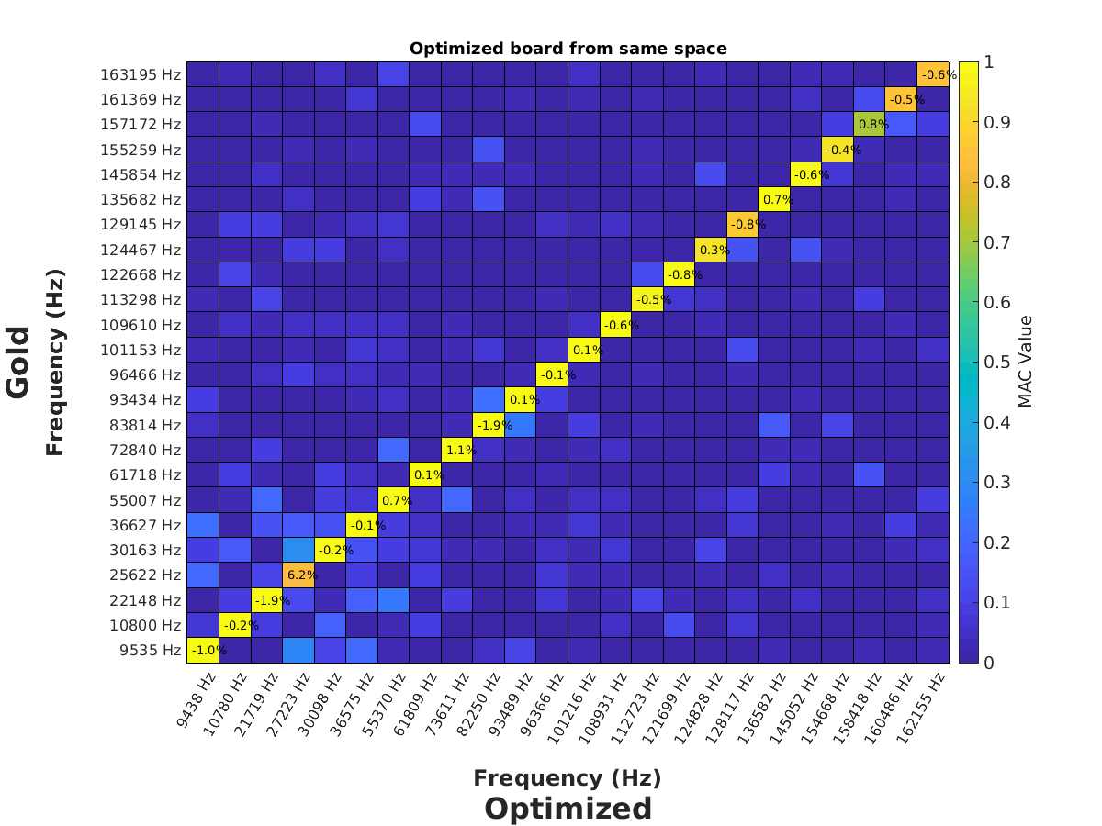
Modal assurance criterion (mac)
Notes:
Ryan

Slide 16
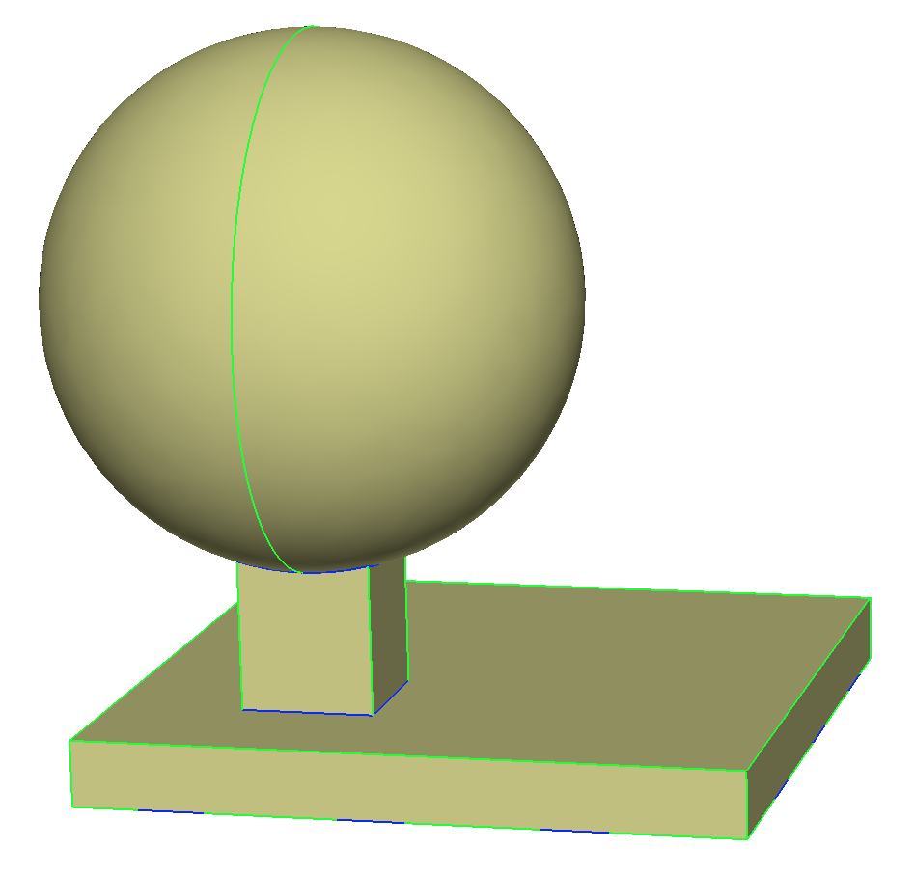
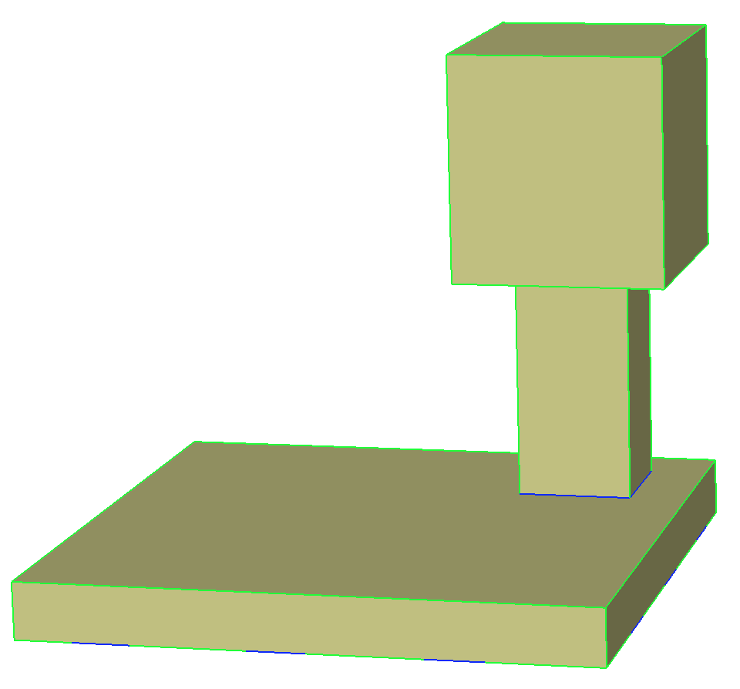
Mass Mock Modal Matching
Initial
Gold
Notes:
Ryan

Slide 17
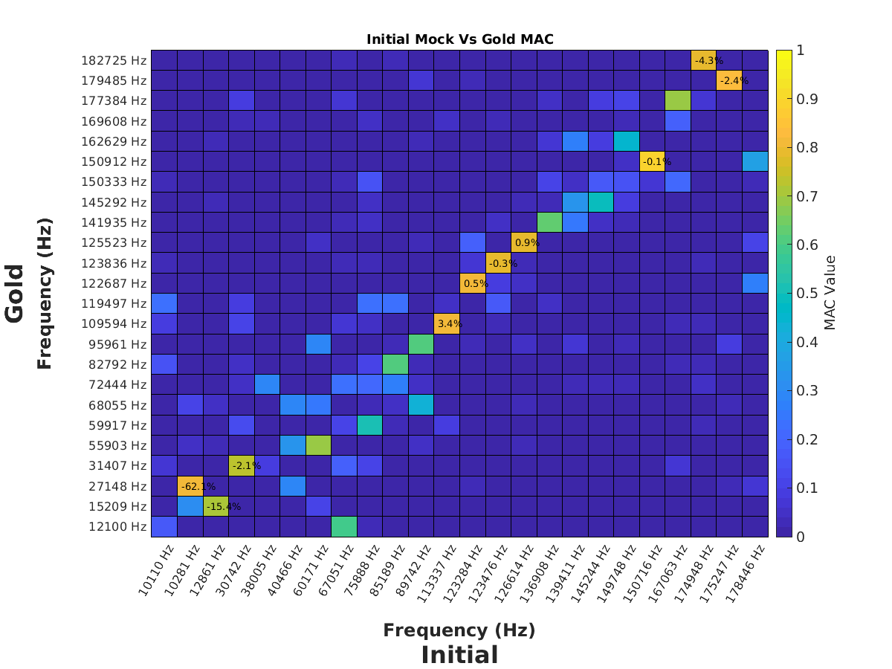
Modal assurance criterion (mac)
Notes:
Ryan

Slide 18
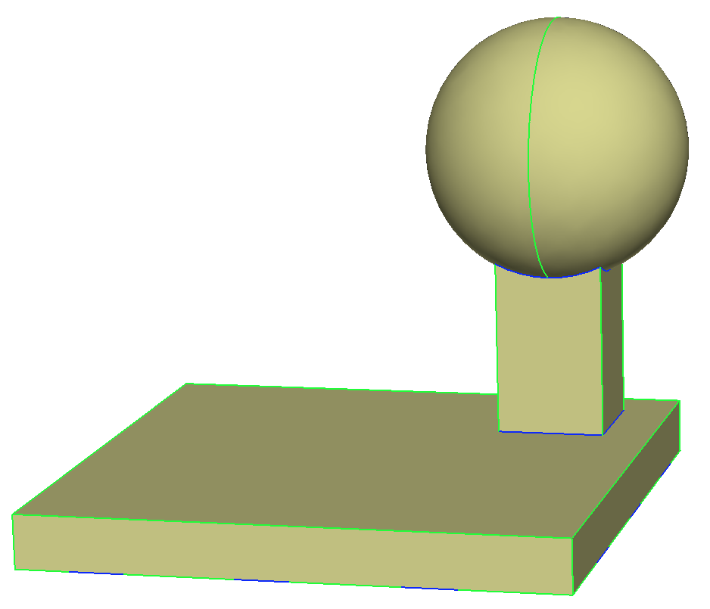
Mass Mock Modal Matching
Optimized
Gold
Notes:
Ryan

Slide 19
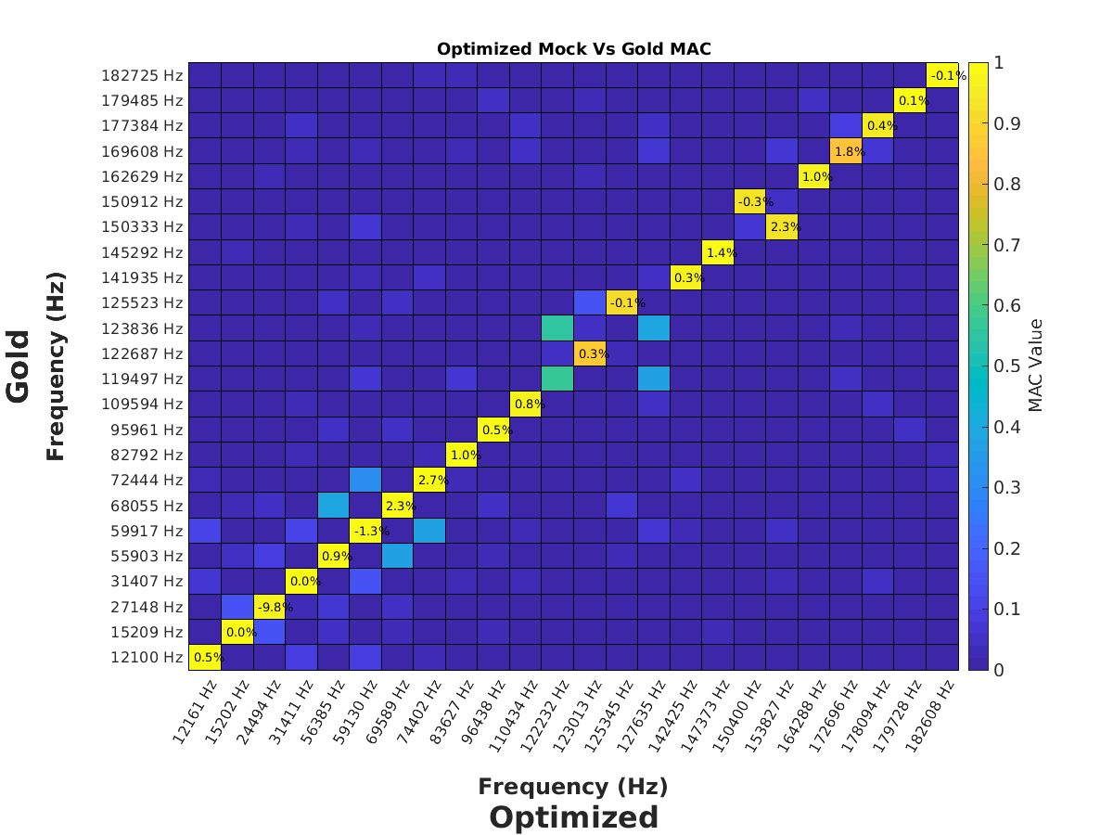
Modal assurance criterion (mac)
Notes:
Ryan

Slide 20
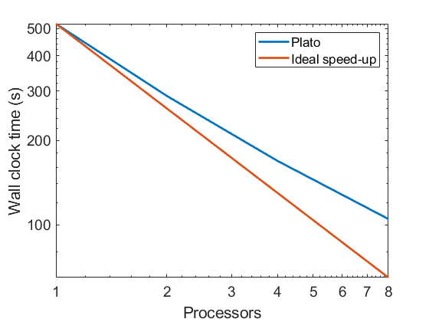
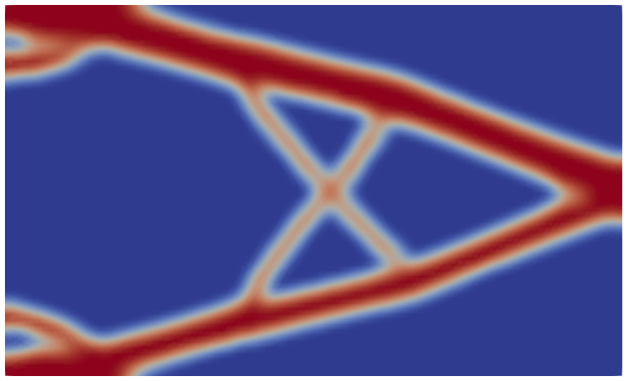
Parallelization of Stochastic ROL
Customer: ASC
Purpose:
Epic Goal: Integrate stochastic ROL methods
Sprint Goal: Implement parallelization
Stochastic methods evaluate large numbers of samples
Batch compute objectives/gradients over available physics codes
Future work:
Write report
Impact:
Running stochastic problems is more practical
Gaussian distribution load
32 samples

Slide 21
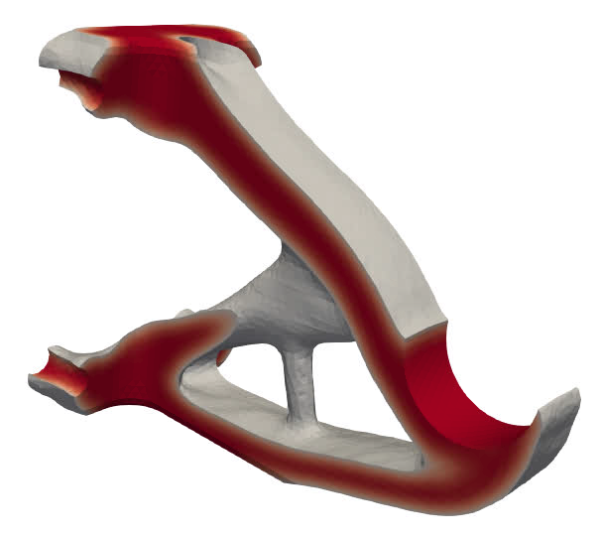
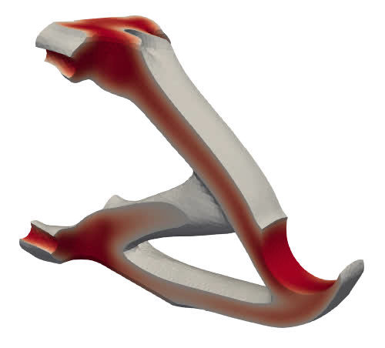
V&V Project Final Report
Customer: ASC
Purpose:
Epic Goal: Integrate stochastic ROL methods
Sprint Goal: Write final V&V report
Summarized work completed and implementation details
Demonstrated parallel speed-up
Provided examples of larger scale problems
Impact:
Reporting and documentation of stochastic optimization features
Risk neutral
Risk averse

Slide 22
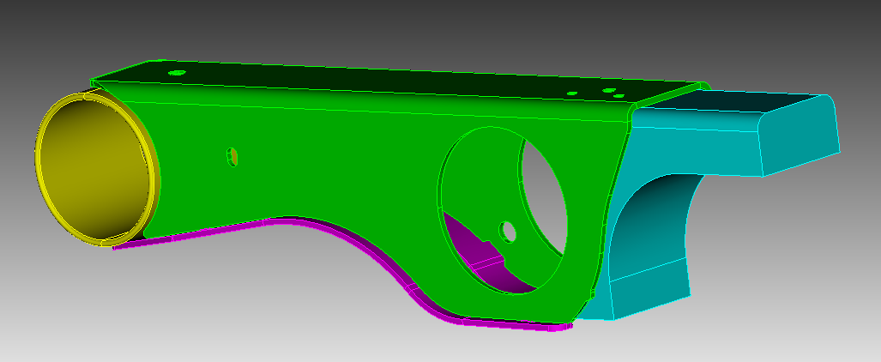
Bracket Optimization
Purpose:
Sprint Goal:
Validate bracket designs
Follow-up optimization
Stress constrained mass minimization
Results:
Provided several optimized designs for different stress constraints
Customer to additively manufacture in 316 stainless
Design volume
Notes:
Sean

Slide 23
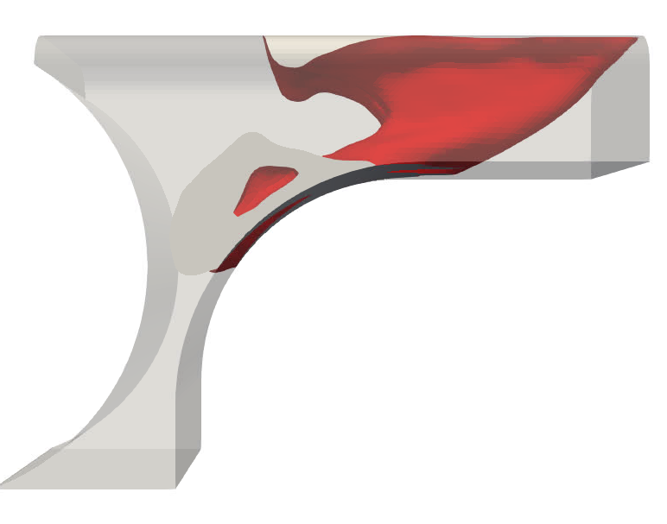
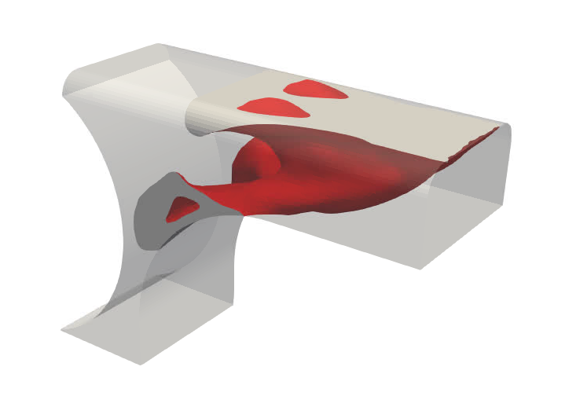
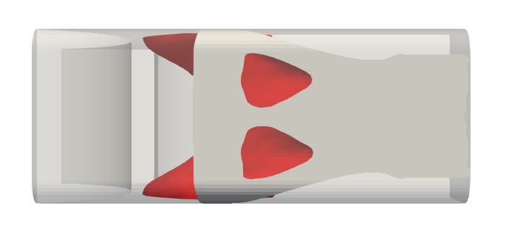
316 Stainless Steel
Stress constraint: 50.4 ksi
Volume: 23.6 in³
Mass: 6.7 lbs
Vol frac: 15.2%
Original volume: 155.2 in³
Original mass: 44.5 lbs

Slide 24
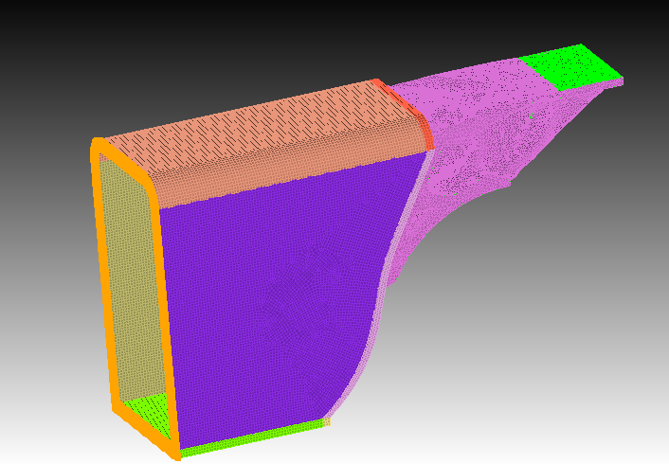
Analysis Results
Extract surfaces from results
Remesh with tets
Run in Sierra/SD with a mounting bracket to mimic trailing arm and tet10 elements
Tied contact BC for weld at interface of the two blocks
Fixed BCs placed on back of bracket
Fixed

Slide 25
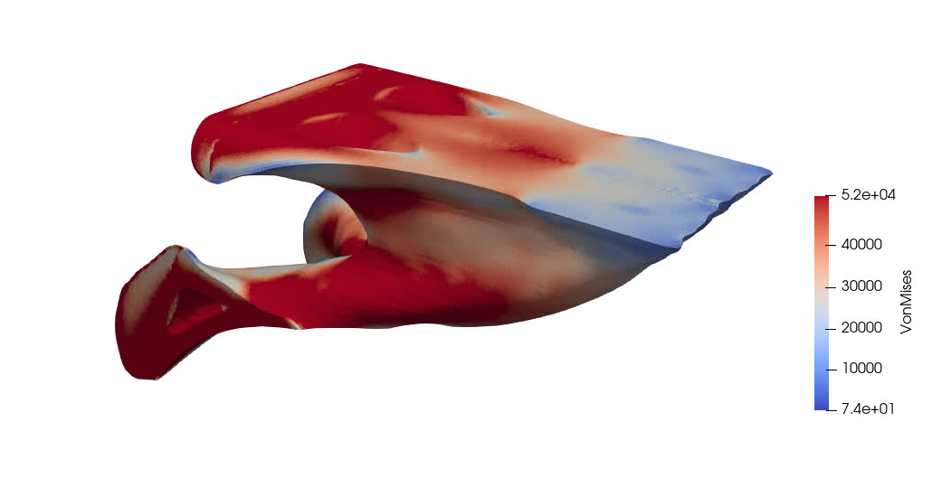
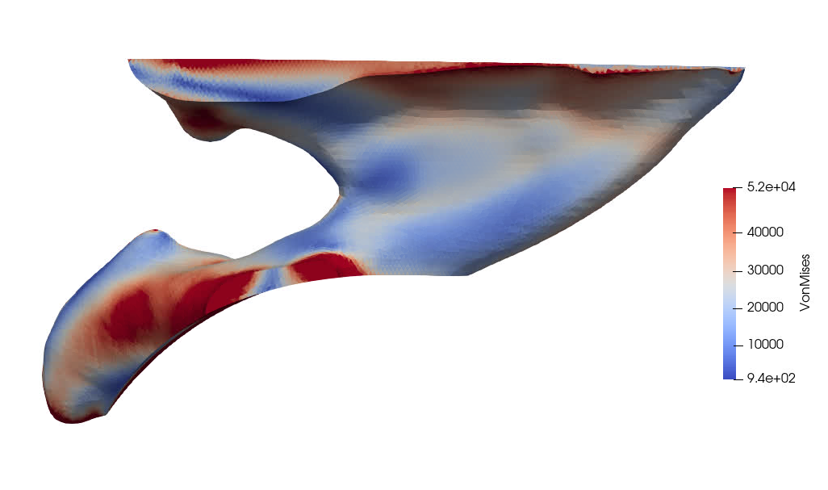
316 Stainless Design
Max Von Mises stress >300 ksi
Von Mises stress, capped at 52 ksi
Yield strength 59 ksi
Center cut-through

Slide 26
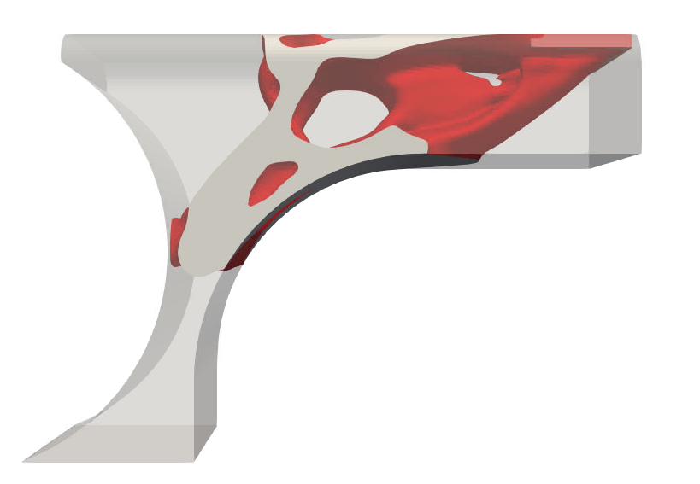
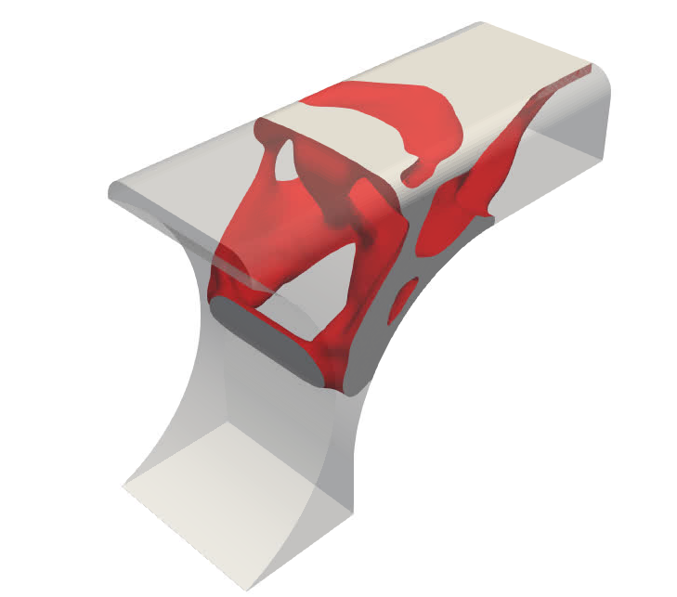
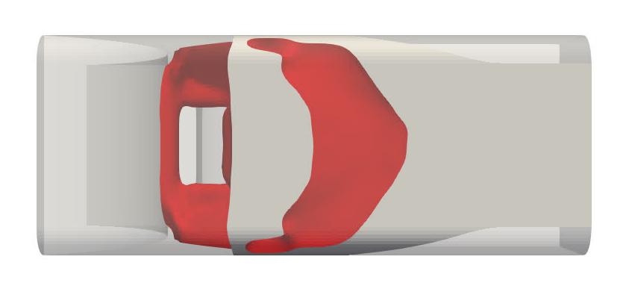
Modified fixed BCs
Fixed tangential displacement components
Free normal components
Stress constraint: 50.4 ksi
Volume: 35.5 in³
Mass: 10.2 lbs
Vol frac: 22.8%
Original volume: 155.2 in³
Original mass: 44.5 lbs

Slide 27
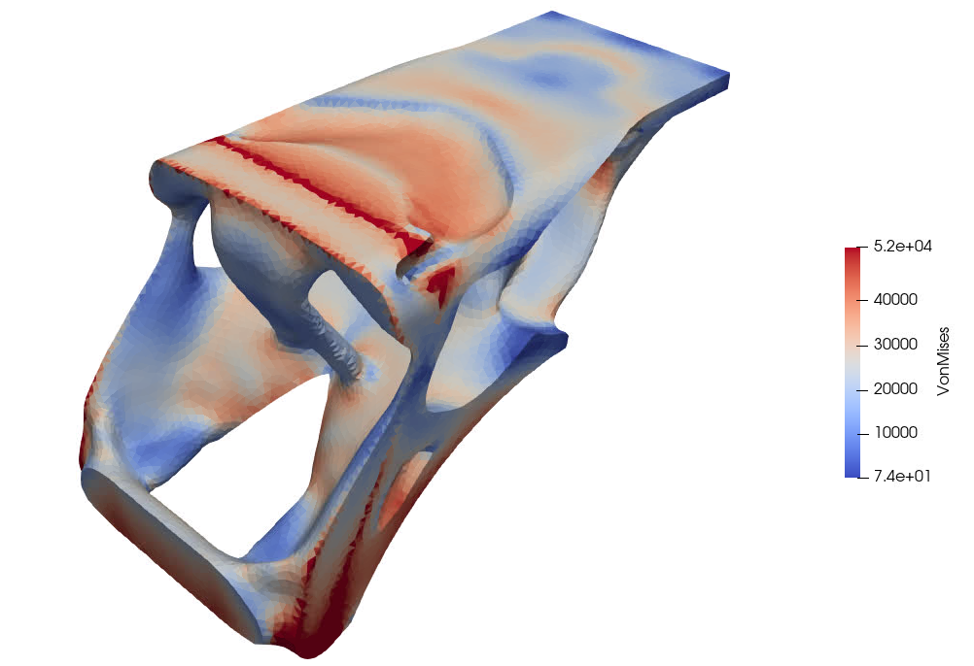
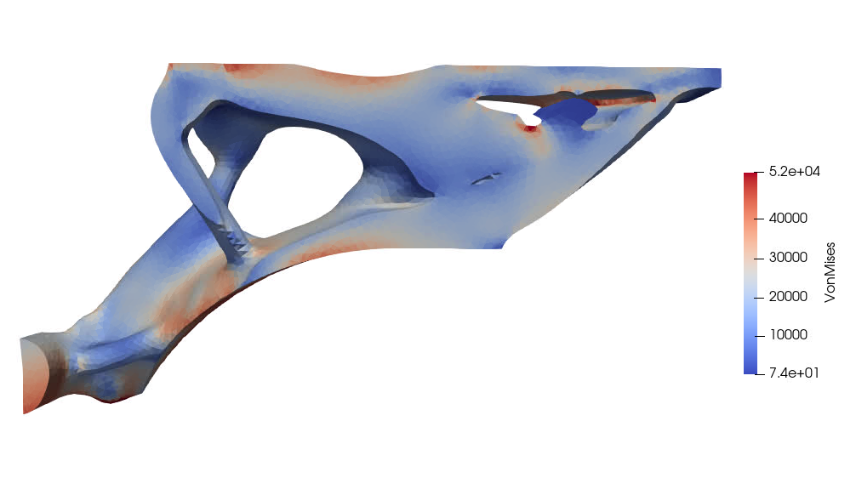
Modified fixed BCs
Von Mises stress, capped at 52 ksi
Center cut-through

Slide 28
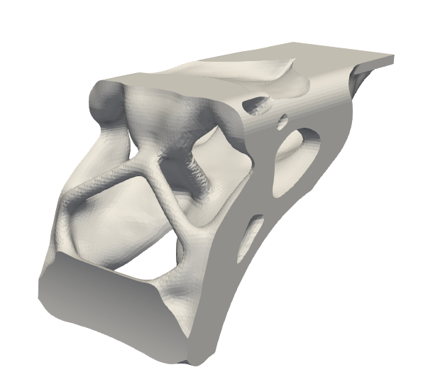
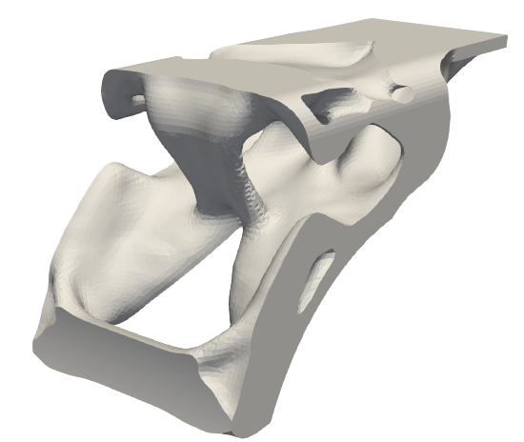
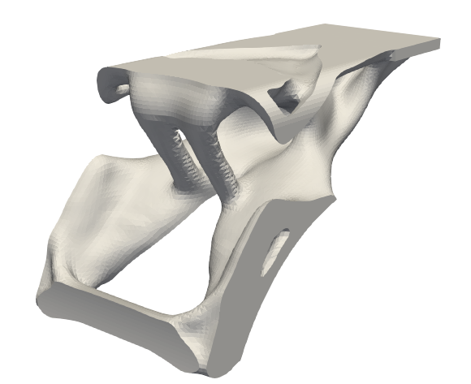
316 stainless steel
Stress constraint: 60% yield strength (35.6 ksi)
Mass: 12.7 lbs
Stress constraint: 70% yield strength (41.5 ksi)
Mass: 10.3 lbs
Stress constraint: 80% yield strength (47.5 ksi)
Mass: 8.7 lbs

Slide 29
conclusion: Direction of plato
Plato has an entrepreneurial history…
Focus on research capabilities: proof of concept without maturation
Development of its own optimizers, physics code
Success in proving capability, bringing in SPP, LDRD funding
but now is becoming a production code:
Strengthening Agile practices
Incorporation of Continuous Integration (CI)
Switch to ROL, pivot focus to Sierra Mechanics while maintaining AM engagements
Desired relationship with Trilinos:
Strong collaboration with ROL on research, optimizer development, stochastic problems
Continued engagement with Kokkos for performance portability
Development of Tacho: need for performance-portable shared-memory sparse-direct linear solver

